Slide 1
Pensions 101
A basic explanation of pensions, and how they work
INTERNAL USE ONLY
ICG members only
September 2022

Slide 2
What do you know about Pensions then?
  Worked in financial services sector for 30 years
  Firstly client side
  Then as a specialist qualitative researcher
  During my career, conducted multitude of projects looking at all aspects of pensions
  BUT
  I am NOT a financial adviser or in any way qualified to give professional advice
  Rather this is an ‘informed layperson’s’ guide to pensions based on my personal understanding and experience
  All comments relate to the 2022/23 tax year

Slide 3
What is a pension plan?
  A long term savings plan with tax breaks
  A pot of cash that you pay into and on which you can get tax relief, but you cannot withdraw your money until you are 55 (rising to 57) and withdrawals will be subject to tax
  Putting money in (accumulation)
  A tax sheltered ‘wrapper’ to save money for your retirement
  You pay money in (regular contributions, one off payments or a combination of the two) and this money is invested, giving it the opportunity to grow over time
  Taking money out (decumulation)
  Draw money from your plan, or exchange all/ part of the cash for a guaranteed regular income until death (an annuity)
  Saving
  Taking income
  You are giving up disposable income now in exchange for a future income

Slide 4
  There are two main categories of pension plan …
  Defined benefit (DB)
  Provided by employers, and often called occupational schemes
  Promise to pay you a set benefit (irrespective of the underlying investment performance)
  Expensive to provide – and have become increasingly rare as companies have moved away from them
  You may have legacy schemes from some old employers
  Defined contribution/ money purchase (DC)
  You/ your employer puts money into the scheme and it is invested. What you have at retirement depends on how those investments have performed
  Within DC, there are different styles of plans with slightly different approaches – the main ones are;
  Workplace pension scheme: You/ your employer make regular monthly payments. You may not have a choice of investments (likely to be a legacy plan)
  Stakeholder pension: a ‘bare bones’ plan, heavily regulated with capped charges, default investment options and low/ flexible minimum contributions
  (Group) personal pension: taken out by you, or by your employer. Offer a choice of investments
  Self invested personal pension (SIPP): a DIY plan for more engaged/ confident, offer a greater choice of investment options
  Small self administered pension scheme (SSAS): very technical, set up via a trust, only for those who know what they are doing!
  DC pensions all follow the same fundamental approach - there are no ‘special’ plans for the self employed/ directors (although they may be marketed as such)

Slide 5

  What is auto-enrolment?
  All employers must provide a workplace pension scheme and make at least 3% (of pay) contributions into it
  The employer and employee between them must contribute at least 8%
  The employee does not have to contribute (but this is very rare nowadays!)
  Employees are automatically enrolled in the scheme (they don’t need to ask) if:
  They are classed as a worker
  They are aged between 22 and State Pension age
  They earn at least £10K per year
  You do not need to set up a workplace pension if:
  You are self employed or a sole trader
  If you are the only director, or your company has two or more directors but none have employment contracts
  BUT as soon as you take on a member of staff you officially become ‘an employer’ and must set up a workplace pension plan
  If you employ staff (even just one person) you must set up a workplace pension

Slide 6
  Choosing a pension plan – what to consider
  There are hundreds of plans on the market, so how do you choose?
  Investment options
  How will your money be invested – what choices do you have?
  Is the fund diversified to manage risk/ reflect your risk profile?
  Fees
  What pension charges will you have to pay?
  Annual management charge: day to day cost of administering the pension (1% or less is good, more than this is not!)
  Platform charge: cost of the platform where you buy and sell shares of funds
  Fund charge: each fund has a fee charged by the fund manager. Actively managed funds cost more than ‘passive’/ tracker funds
  Try to keep fees to a minimum – they can really eat into your investment returns
  Are there exit fees if you leave the plan/ transfer the money to another plan (consolidation) or take benefits early?
  Flexibility
  What are the minimum/ maximum contributions?
  Can you ‘mix and match’ your contributions – lump sums and regular amounts?
  If it’s your own personal pension plan, can your employer pay into the scheme?
  Can you manage your pension/ investments online – check balances, make contributions, switch investment funds etc?
  Make a short list, and ask for the Key Facts Document to compare. Check whether you have any existing plans that will accept additional contributions or that have specific benefits (e.g. low charges)

Slide 7
  Managing your pension investment
  Your pension is an investment - the money you pay into you pension plan is invested in pension funds for you
  The ‘provider’ (Aviva, L&G etc) offer the ‘wrapper’ – beneath which sits the investment funds (which may be with totally different companies)
  Someone, somewhere has made a choice of investment for you
  You/ your adviser may have done this when you first set up the scheme
  Or you may have gone into a ‘default’ fund (for people who can’t or don’t want to make their own investment choices)
  Most pension schemes involve an element of risk as the value of investments can go down as well as up
  However, they are typically long term (20+ years), so the general trend is for them to grow…
  A pension fund is made up of a portfolio of assets – stocks, shares, bonds, cash, property – the mix of these varies across different funds
  Monitoring your pension fund is important to make the most of your investment - how is your money invested, and is it diversified to manage risk/ reflect your risk profile or preferences (e.g. ethical investments)?
  Normally good to have a blend of assets – you can choose as many or as few funds as you like
  Typically you will be offered
  Funds that specialise in specific assets – geographical, ethical funds, risk adjusted funds etc
  Fund that invest in a broad range of different assets
  Often pension companies offer ‘lifestyle funds’ – alter risk profile as you approach a target date
  How have your funds performed in the past? Have you reviewed your funds recently? What are the charges?

Slide 8
  Pensions and tax/ deductions: Some key definitions …
  Income tax
  Personal allowance £12,570 = 0% tax
  Basic rate tax £12,571 - £50,270 = 20% tax
  Higher rate tax £50,271-150,000 = 40% tax
  Additional rate tax over £150,000 = 45% tax
  Dividend tax
  The company must be making a profit (after tax) in order to pay a dividend
  Dividend allowance £2,000 = 0% tax
  Basic rate = 8.75% tax
  Higher rate tax = 33.75% tax
  Additional rate = 39.35% tax
  National insurance contributions (payable on PAYE income)
  Employees: Class 2 @13.25% on income above £11,908
  Employers: Class 1 15.05% on income above £9,100
  Self employed: 10.25%
  Taking a salary* where the director pays 0% NIC ensures you qualify for pension, sickness and other benefits
  These figures include the 2022/23 NI additional Health and Social Care Levy of 1.25% (which will be charged separately from April 2023)
  Corporation tax
  19% payable on company profits
  This rate is going up to 25% 2023/24 financial year
  (Note: sole traders/ self employed pay income tax on the profits that the business makes assessed through self assessment tax return)
  Rates related to the 22/23 financial year – which is a funny one due to the levy and some other mid-year changes made by the Government to align the NIC/ Dividend/ Income tax thresholds …these figures are ‘typical’ but your details may be marginally different to this. * To qualify your salary needs to be above the lower earnings limit (£533 per month) – but keep it below the Primary/ Secondary thresholds to avoid NIC

Slide 9
  Making personal contributions and claiming tax relief
  You cannot claim tax relief on pension contributions based on dividend income – so if you pay yourself a smaller salary and larger dividend, your tax relief will be proportionally low
  Basic tax relief of 20% – typically automatic
  Workplace pension: taken out of your pay by your employer before deductions for income tax are made
  Otherwise your pension provider will claim it as tax relief and add it to your pension pot (relief at source)
  The maximum you can pay into your pension from your personal funds during a single tax year and get tax relief is the lower of:
  100% of your PAYE salary/ ‘relevant earnings’ (potentially a limitation for owner/ directors of small limited companies)
  £40,000 (the annual allowance)
  You can pay in more than £40,000/ your PAYE salary, but you will not be able to claim tax relief on this (subject to carry-over rules)
  Higher rate tax payer?
  You can claim an additional 20% (or if you are a top rate tax payer, 25%) through your self assessment tax return

Slide 10

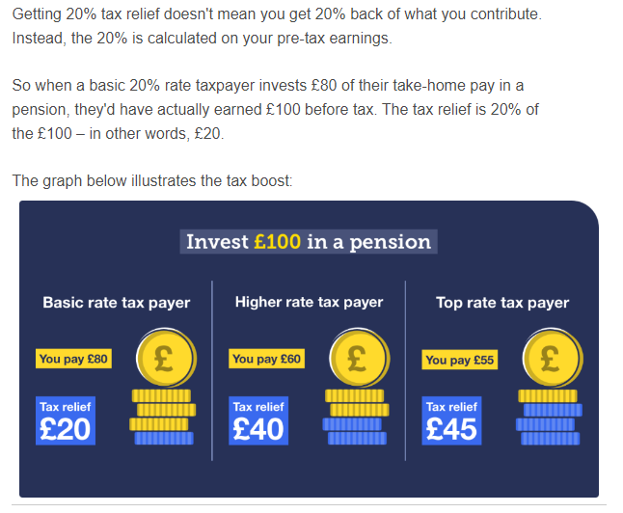
  Pensions tax relief in practice: An example
  Pension tax relief can play an important part in boosting your retirement savings because, effectively, HMRC is topping up your contributions
  Also, it is likely that you income will reduce when you retire – so you will pay less tax

Slide 11

  Making contributions through your limited company
  As a company director of your own limited company you can make contributions both as a business (through employer contributions) and as an individual
  Typically this combination will maximise the tax benefits but it does depend on your individual circumstances and the business’s profits
  Rather than draw extra income to pay a personal contribution, contributions can be paid by your company – because it counts as an employer contribution it is treated differently for tax purposes
  Tax efficient way of using profits from your business – no tax or NI liabilities on the money paid into the pension
  You can claim tax relief from contributions you make from your earned income, and corporation tax relief on the contributions made my your company
  You can still be paid tax-efficiently by taking the bulk of your income as dividends
Figures on the net suggest a total combined tax/ corporate NI saving of around 38.8% by paying directly into your personal pension from your business rather than paying it in the form of salary

Slide 12

  Making contributions through your limited company
  The benefits
  They are an allowable business expense, saving corporation tax (currently 19%)
  Pension contributions come out of pay before NICs are determined, so the employer NICs are lower
  No dividend tax on the money you ‘sacrifice’
  Contributions are not limited by the size of your salary
  The limitations
  Contributions must meet HMRC’s ‘wholly and exclusively’ rules
  Pension remuneration is appropriate to that individual/ reasonable for the work being done - you should also make similar contributions to others in the company doing work of a similar value
  Pension contributions should not be more than the company’s annual profits (likely to be the maximum that your company can contribute)
  Contributions made by an employer do count towards your annual allowance
  You cannot claim individual tax relief on a company contribution

Slide 13
Examples: Making pension contributions and claiming tax relief
It is horribly complicated!
  The example is based on taking a total gross income of £60,000 from which you want to make a pension contribution of £15,000
  The illustrations do not take into account any other personal/ corporate circumstances, but have been made in isolation (no doubt breaking all sorts of accountancy protocols in the process!)
  £60K shows the impact of higher rate tax bands – if you take less, the differences will be more marginal
  I have assumed that your business has made sufficient profit to allow the contribution to be made
  Figures are approximate, and calculated based on my current (layperson’s) understanding of the tax regime (which is complex) – I do not guarantee to have got them correct!
  Specific figures will depend on each individual’s business and personal circumstances
  Please assume that they are ‘illustrative’ (rather than exact!) and I assume no responsibility for any errors (I am a qual researcher after all!)

Slide 14
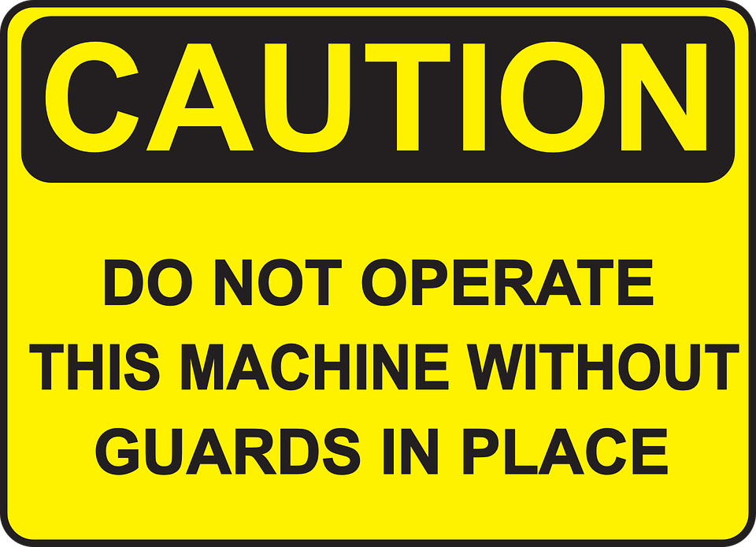
  A salaried approach
  Your earnings are £60K (all of which is taxable income)
  Your total personal tax bill is £11,432
  You do not pay tax on the first £12,570
  You pay tax of 20% on £37700 = £7,540
  You pay 40% tax on £9,730 = £3,892
  The NIC bill
  You pay £5,400 employees NIC
  Your company also pays £7,660 NIC
  Salaries are an allowable business expense – so there is no corporation tax due
  You decide to put £15,000 into your pension
  You automatically get 20% tax relief at source on the full £15,000 = £3,000
  You claim an extra 20% tax relief on £9,730 (the same amount you paid higher rate tax on) = £1,946
  You do not get additional tax relief on the remaining £5K
  Total tax/ NIC = £24,492
  Total pension relief = £4,946

Slide 15
  Mix of dividends and salary
  You take £60,000 - £9,100 as PAYE salary and £50,900 as dividends
  Your personal tax bill payable on your dividends is £5,733
  You do not pay tax on the PAYE salary of £9,100
  A further £3,470 is left over from your personal allowance, plus your initial £2,000 dividend allowance – so another £5,470 is tax free 0
  Of the remaining amount, you pay dividend tax
    8.75% on £35,700 = £3,123
    33.75% on the next £9,730 = £3,283
  Your company pays corporation tax on profits before dividends are distributed
  19% on £50,900 = £9,671
  Because your salary is below the NIC limits, there is no NIC payable
  You decide to put £15,000 into your pension
  BUT hang on, you can’t put £15,000 in and claim tax relief on it!
  You are limited to what you can put in and claim tax relief on to your salaried income for that year – so the maximum you can claim is on £9,100!
  You automatically get 20% tax relief at source on £9,100
  You get no further pensions tax relief
  Your pension at retirement is smaller
  Total tax/ NIC = £16,078
  Total pension relief = £1,820

Slide 16
  Making contributions through your limited company
  You take £45,000 - £9,100 as PAYE salary and £35,900 as dividends – and sacrifice £15,000 for the pension contribution
  Your personal tax bill is £2,663
  You do not pay tax on the PAYE salary of £9,100
  A further £3,470 is left over from your personal allowance, plus your initial £2,000 dividend allowance – so another £5,470 is tax free
  Of the remaining amount, you pay dividend tax of 8.75% on £30,430 = £2,662
  Your company pays corporation tax on profits before dividends are distributed
  19% on £35,900 = £6,821
  Because your salary is below the NIC limits, there is no NIC payable
  Your company puts £15,000 into your pension
  The amount you company can put in is not limited to your salary… so it can put in the full £15,000
  You get no further pensions tax relief
  Because pension contributions are an allowable business expense, your company does not pay tax on £15,000 (an effective saving of £2,850)
  Your income ‘looks’ lower – so it could affect your credit?
  Total tax/ NIC = £9,484
  Total pension relief = £0

Slide 17

  Pension vs ISA: what are the differences?
  Similar to a Pension, an ISA is a ‘wrapper’ which shelters your savings from tax
  You select whether you want a cash ISA, or an ISA that invests in the stock market – the range of funds is typically similar to that for pensions
  You can save up to £20,000 per year
  Your contributions are made from your taxed income
  ISAs do not attract any capital gains tax, or tax on income – you do not need to declare ISA income or investment gains on your tax return
  Any money you take out of an ISA is tax free
  Note that the personal savings allowance protects £1,000 a year for basic tax payers (i.e no tax on the first £1,000 p.a interest) so most people don’t pay tax on their savings anyway
  You can access your money whenever you want to
  You can leave your ISA to whoever you want – but if it is not your spouse/ civil partner, it will be taxable
  ISAs are taxed on the way in, pensions are taxed on the way out!

Slide 18
  How much can you pay into your pension
  Annual allowance
  Tax relief is available on the lower of 100% annual earnings and £40,000 including the tax relief added
  Because personal contributions benefit from tax relief on contributions the max anyone can pay from their earned income in reality is £32,000 with the remaining 8K coming from tax relief
  The allowance is worked out using the current year’s allowance and any unused allowance from the previous three tax years – but you can only receive tax relief on contributions equal to your earnings in the tax year in which you are making the contribution
  Once you take any money from your pension the amount you can contribute to money purchase pensions is reduced to £4,000 p.a.
  Any contributions you make over your annual allowance are taxed at your highest rate
  It is typically recommended that you put in as much as you can afford – lots of calculators online to help you
  But try to work out what income you need in retirement…
  … and calculate back from that
  You can technically put in as much as you like, but the tax treatment will differ if you go over your allowances
  Lifetime allowance
  Currently set at £1,073,100, any pension savings (this is the total value of your pension pot) you have over this amount could be taxed at 55%

Slide 19
  When can you access your money & the tax implications
  Normally up to 25% of your pension can be taken tax free
  When you buy an annuity, or move funds into drawdown, up to 25% can usually be taken as a tax free lump sum at the start
  If you are taking lump sums directly from your pension, 25% of each lump sum is normally tax free
  Other than your 25% tax free cash, other income payments or withdrawals are subject to income tax in the same way as earned income
  Added to any other taxable income you have received in that tax year
  If you take large withdrawals you could be pushed into a higher tax bracket – on the other hand, spreading your withdrawals over more than one tax year can help make the most of your personal allowances
  All pension providers deduct income tax before paying any withdrawals using PAYE code
  When you first take a taxable withdrawal it is likely your provider will use an emergency tax code – you need to reclaim any overpaid tax directly from HRMC
  You can take as much money out of your pension as you want from age 55 (rising to 57 in 2028)
  However, any pension money you take is treated like income (after the tax free 25%) - the more you take out the higher your tax bill is likely to be
  To minimise the tax you pay, you need to be clever with the amounts and timing to stay within the tax thresholds
You will need to work out your tax liability and whether it is better to take your tax free cash as one lump sum, or take your 25% in bits

Slide 20

  How can you take your money?
  Annuity
  You exchange all or some of your pension pot for a secure income for life
  You income is guaranteed and will never run out, but it can’t be changed once it is set up
  You can choose different types of annuity with different benefits
  Drawdown
  Take a flexible income directly from your pension – as much as you like, when you like
  The remaining money stays invested so it has a chance to grow
  But your income is not guaranteed – you could run out of money if your investments perform poorly, you take too much out or your life longer than you expect
  And you may be subject to charges (set up, admin, platform charges, fund charges etc)
  Lump sums (UFPLS)
  Your money stays with your current pension and you take lump sums directly from your pension as you need it
  The remaining pension stays invested and your future fund value and income are not secure
  Unless you take an annuity, the money remaining in your pension is still invested – so you still need to manage it/ keep an eye on it

Slide 21

  What happens when you die?
  Pension pots are not subject to inheritance tax – but any money you have taken out is treated as cash and will form part of your estate
  If you are in drawdown/ UFPLUS and
  … have not started taking your pension
  Your pension will go into your estate and the recipient is usually not liable for tax on it (pensions are not subject to IHT)
  … you have started taking your pension
  Your beneficiaries can normally access whatever is left tax free
  (Note: There is a different rule if you die after age 75 which may mean the pension is taxed …)
  If you have bought an annuity
  Income will usually stop when you die and there is no residual value left – your beneficiaries will receive nothing
  Income may continue if your annuity has a ‘guaranteed’ period or if you have chosen a ‘widows/ widowers’ pension
  Typically these annuities cost more – so you will get a reduced income amount in return for these options

Slide 22
Any questions?
INTERNAL USE ONLY

