Slide 1


Bad data causes bad decisions:
How to solve the problem of data quality in your online research

Slide 2


Meet the Prolific team
Andrew Gordon
Research Consultant

Slide 3



Gordon et al. (2019)
1000 participants from Amazon MTurk
Basic data cleaning

Slide 4
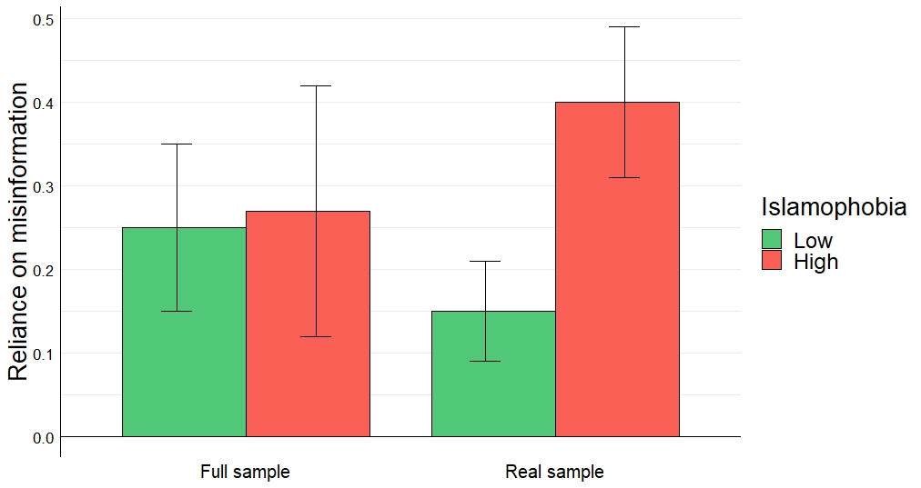
Gordon et al. (2019)
Pre-existing beliefs have no effect on misinformation reliance 👏
Wrote up the study, and submitted a first draft to a journal
Cleared space on my shelf for the Nobel prize

Slide 5
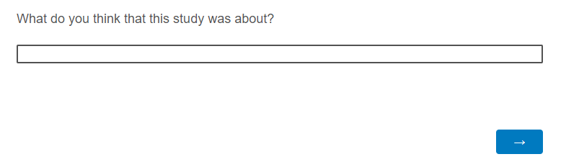

Gordon et al. (2019)
Suspicious answers
Good answers

Slide 6
Gordon et al. (2019)

Slide 7

¹ Data Management Association (2021)
² Behrend et al. (2011)
³ Peer et al. (2017)
What is ‘data quality’?
Good quality data are data that are fit for their intended purpose
You need to decide which factors you put most weight on depending on your specific research goals
e.g., Attrition, Comprehension, Naivety, Reliability, Replicability, Speed, Thoroughness ¹
Significant concerns persist about the quality of data from online samples ^{2,3}

Slide 8
⁴ IBM (2016)
⁵ Gartner research (2018)
Why does it matter?
Impact on your bottom line:
The annual cost of data quality issues in the U.S. amounts to $3.1 trillion ⁴
Average financial impact of poor data quality on organizations is $9.7M per year ⁵
Garbage In, Garbage Out (GIGO): Low quality data creates a false view of the world
False positives (Type I errors)
False negatives (Type II errors)

Slide 9
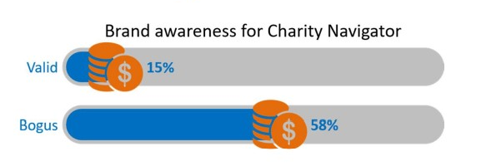
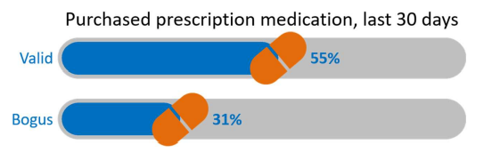
⁶ Harmon Research and Grey Matter Research (2020)
Type I vs Type II
Type I: Seeing relationships where none truly exist
Risk of directing resources towards a dead-end
Type II: Missing significant relationships that do exist
Risk of ignoring potential opportunities

Slide 10


⁶ Harmon Research and Grey Matter Research (2020)
⁷ PEW Research (2019)
Where does low data quality come from?
Low quality data is often due to low quality inputs
Who are you testing?
Up to 46% of all opt-in panel respondents are bogus ^{6,7}
How are you testing them?
95% of researchers eliminate speeders and 90% use CAPTCHAs to filter out survey bots ⁶ - but that's it!

Slide 11
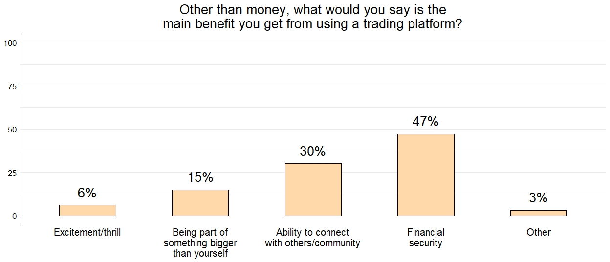
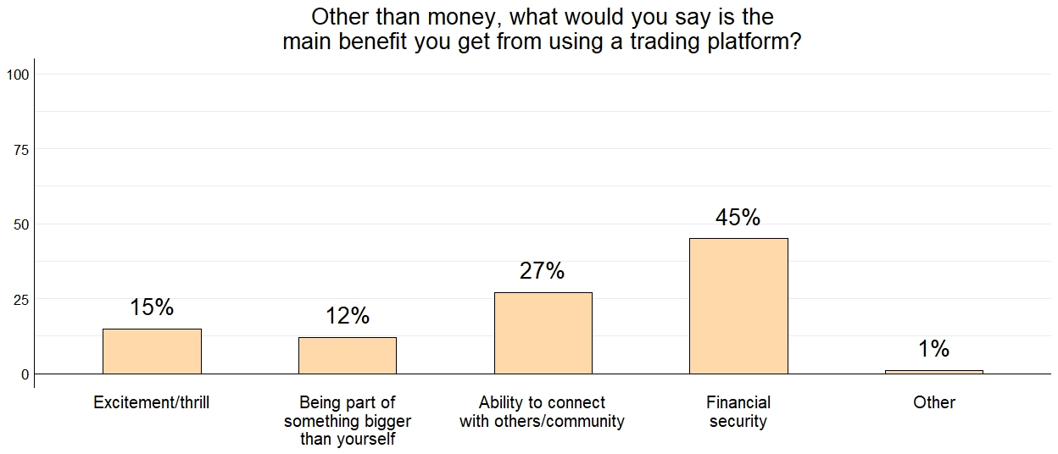
Consumer Perceptions of Trading Platforms (Prolific, 2022)
Where does low data quality come from?
Actual Data
Straightliners added

Slide 12

How to improve your data quality
Pick the platform with the strongest pool
Validate your participants yourself
Choose the right sample to answer your question
Design your study to eliminate bad actors
Treat your participants fairly

Slide 13

Pick the platform with the strongest pool
Not all research platforms were created equal. Things to check are:
  Participant verification
  Level of quality control on the pool
  Active size of the pool
Underlying ‘pool’ quality has been shown to vary greatly between the major providers, meaning that overall data quality also differs significantly

Slide 14
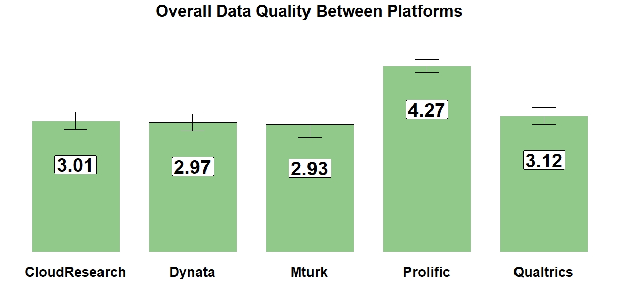
⁸ Peer et al., 2021
Pick the platform with the strongest pool

Slide 15
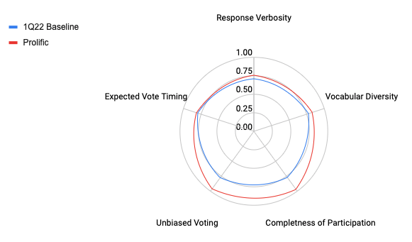
Pick the platform with the strongest pool

Slide 16
How to improve your data quality
Pick the platform with the strongest pool
Validate your participants yourself
Choose the right sample to answer your question
Design your study to eliminate bad actors
Treat your participants fairly

Slide 17

Validate your participants yourself
Within your study, check that your participants are who they say they are
Re-ask your screening requirements. This will allow you to confirm that participants’ prescreening responses are accurate and up-to-date
Never reveal your required demographics in your task description

Slide 18

Validate your participants yourself

Slide 19
How to improve your data quality
Pick the platform with the strongest pool
Validate your participants yourself
Choose the right sample to answer your question
Design your study to eliminate bad actors
Treat your participants fairly

Slide 20
Choose the right sample to answer your question
Not all samples can answer all research questions
Your choice of respondents will have a huge impact on the quality of the data you receive - What is the aim of your research?
Generalisability vs nicheness - which one is more important to you?

Slide 21
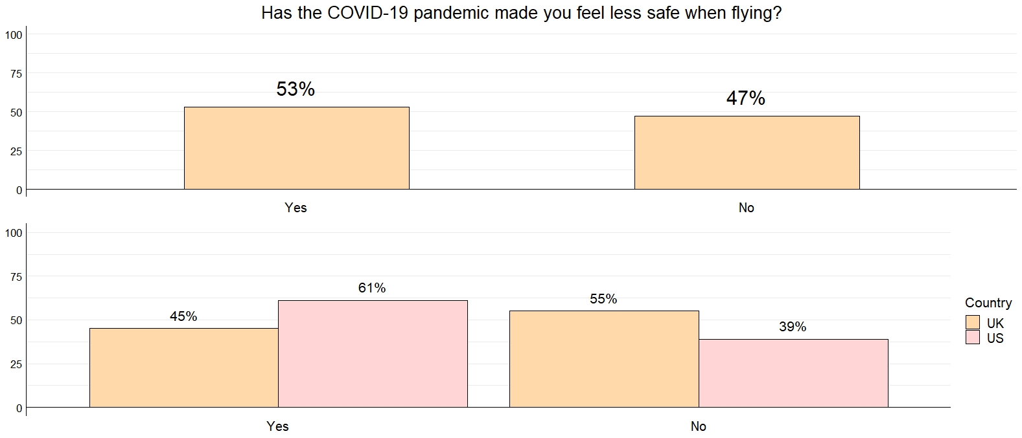
⁹ Consumer Perceptions of Air Travel (Prolific, 2022)
Choose the right sample to answer your question

Slide 22
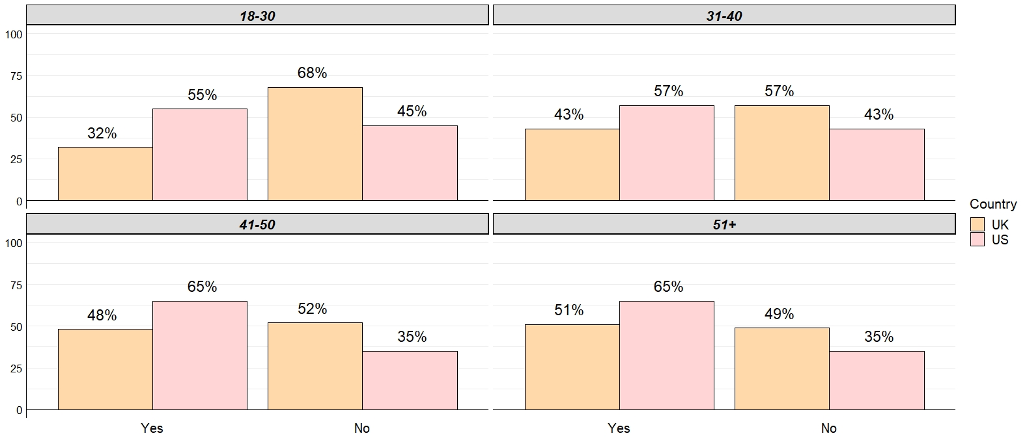
Consumer Perceptions of Air Travel (Prolific, 2022)
Choose the right sample to answer your question

Slide 23
How to improve your data quality
Pick the platform with the strongest pool
Validate your participants yourself
Choose the right sample to answer your question
Design your study and analysis to catch bad actors
Treat your participants fairly

Slide 24

Study design
Include free-text responses
Include CAPTCHAs
Include duplicate questions
Don’t make your study too long
Implement effective attention checks

Slide 25
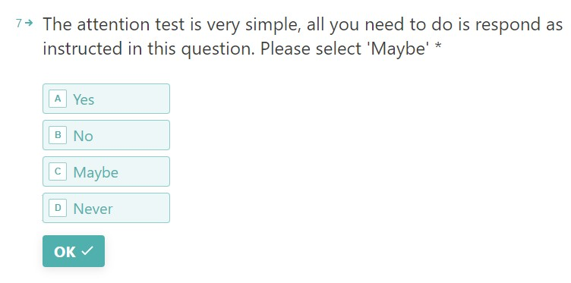
Study design

Slide 26
Data Analysis
Look for duplicate IP addresses
Analyse time taken on each question
Look at length and detail of answers
Check your data for random answering patterns or careless responding

Slide 27
How to improve your data quality
Pick the platform with the strongest pool
Validate your participants yourself
Choose the right sample to answer your question
Design your study and analysis to catch bad actors
Treat your participants fairly

Slide 28

Treat your participants fairly
Participants who are treated fairly are significantly more likely to engage with your research
One of the best ways to do this is by paying them a fair rate for their time
Treat your survey takers as people not machines
Try to sign up as a participant to your own research!

Slide 29

Summary
Data quality is a function of the participants and your study design.
Be skeptical about your sources and evaluate them yourself!
Add free text responses, attention checks, repeated demographic questions to your surveys.
Empathise with your participants – try to take some studies yourself!

Slide 30

Thanks for listening! Any questions?
Lunch-and-learn - Wednesday 21st September: “Prolific: Selecting for the highest quality and most engaged participants”
Sign-up at www.prolific.co/referral/icgweb for £40 free credit
Learn more:
www.prolific.co
@Prolific
@Phelimb
andrew.gordon@prolific.co

