Slide 1

APPLICATIONS OF BEHAVIOURAL SCIENCE TO QUANTITATIVE MARKET RESEARCH
CHRIS HARVEY
OCTOBER 2022

Slide 2




ACTIVATE RESEARCH – BRIEF SUMMARY
We inspire change and drive growth through enabling a deeper understanding of how people think and why they behave as they do
We add complementary insights and approaches from behavioural science (and psychology more broadly) to agencies’ research offer
This enables end clients to better understand, predict and influence target audience behaviour

Slide 3
AGENDA
1. introduction
2. Behaviour change models
3. Behavioural economics
4. Personality psychology
5. Concluding thoughts (and Q&A)

Slide 4

1. introduction

Slide 5
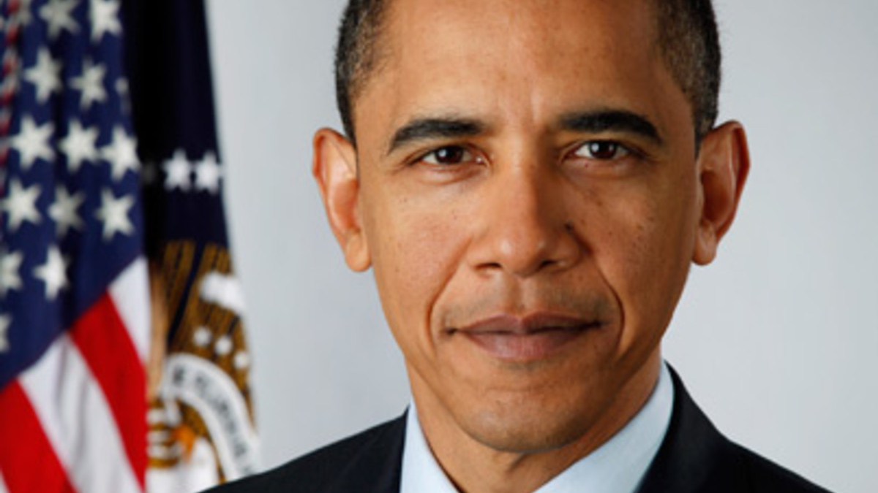
“A growing body of evidence demonstrates that behavioral science insights – research findings from fields such as behavioral economics and psychology about how people make decisions and act on them – can be used to design government policies to better serve the American people…”

Slide 6

COMPLEX, SURPRISING, OR ILLOGICAL JUDGMENTS / BEHAVIOURS…¹
The BBC licence fee costs £145.50 a year. Is this good or bad value for money?
The BBC licence fee costs £12.13 a month. Is this good or bad value for money?
…of which research participants are often unaware
Source: Prospect / YouGov, November 2011.
1. Thaler, R. (2016). Misbehaving: The making of behavioral economics. W.W. Norton & Company.

Slide 7
2. Behaviour change models

Slide 8
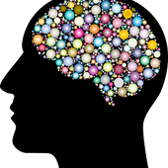
BEHAVIOUR CHANGE MODELS
Operation or mechanism
  Hypotheses
  Structure findings
  Recommend, generate, and test interventions

Slide 9
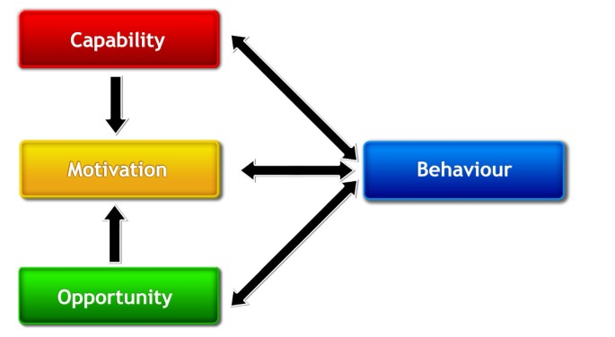
COM-B model
COM-B¹
Strength, knowledge, skills, stamina
Conducive physical, social environment
Sufficiently strong motivation
1. The behaviour change wheel: a new method for characterizing and designing behaviour change interventions

Slide 10
MODEL IN ACTION – BASIC APPROACH
Q: To what extent would you need each of the following in order to prescribe <XXX> more than you currently do?
Agreement scale
Barriers to prescribing
COM-B informed by prior research
All three types of factor key
Structure
High appeal/ITT not always enough
Capability
Opportunity
Motivation
Source: Client study, with results adjusted by +/- 1% (n=640)

Slide 11
MODEL IN ACTION – ADVANCED APPROACH
Inter-connecting influences
Current levels
Knowledge – Comfort
Create change

Slide 12
SUMMARY
Current behavioural influences
Factors of which people may be unaware

Slide 13
3. Behavioural economics

Slide 14
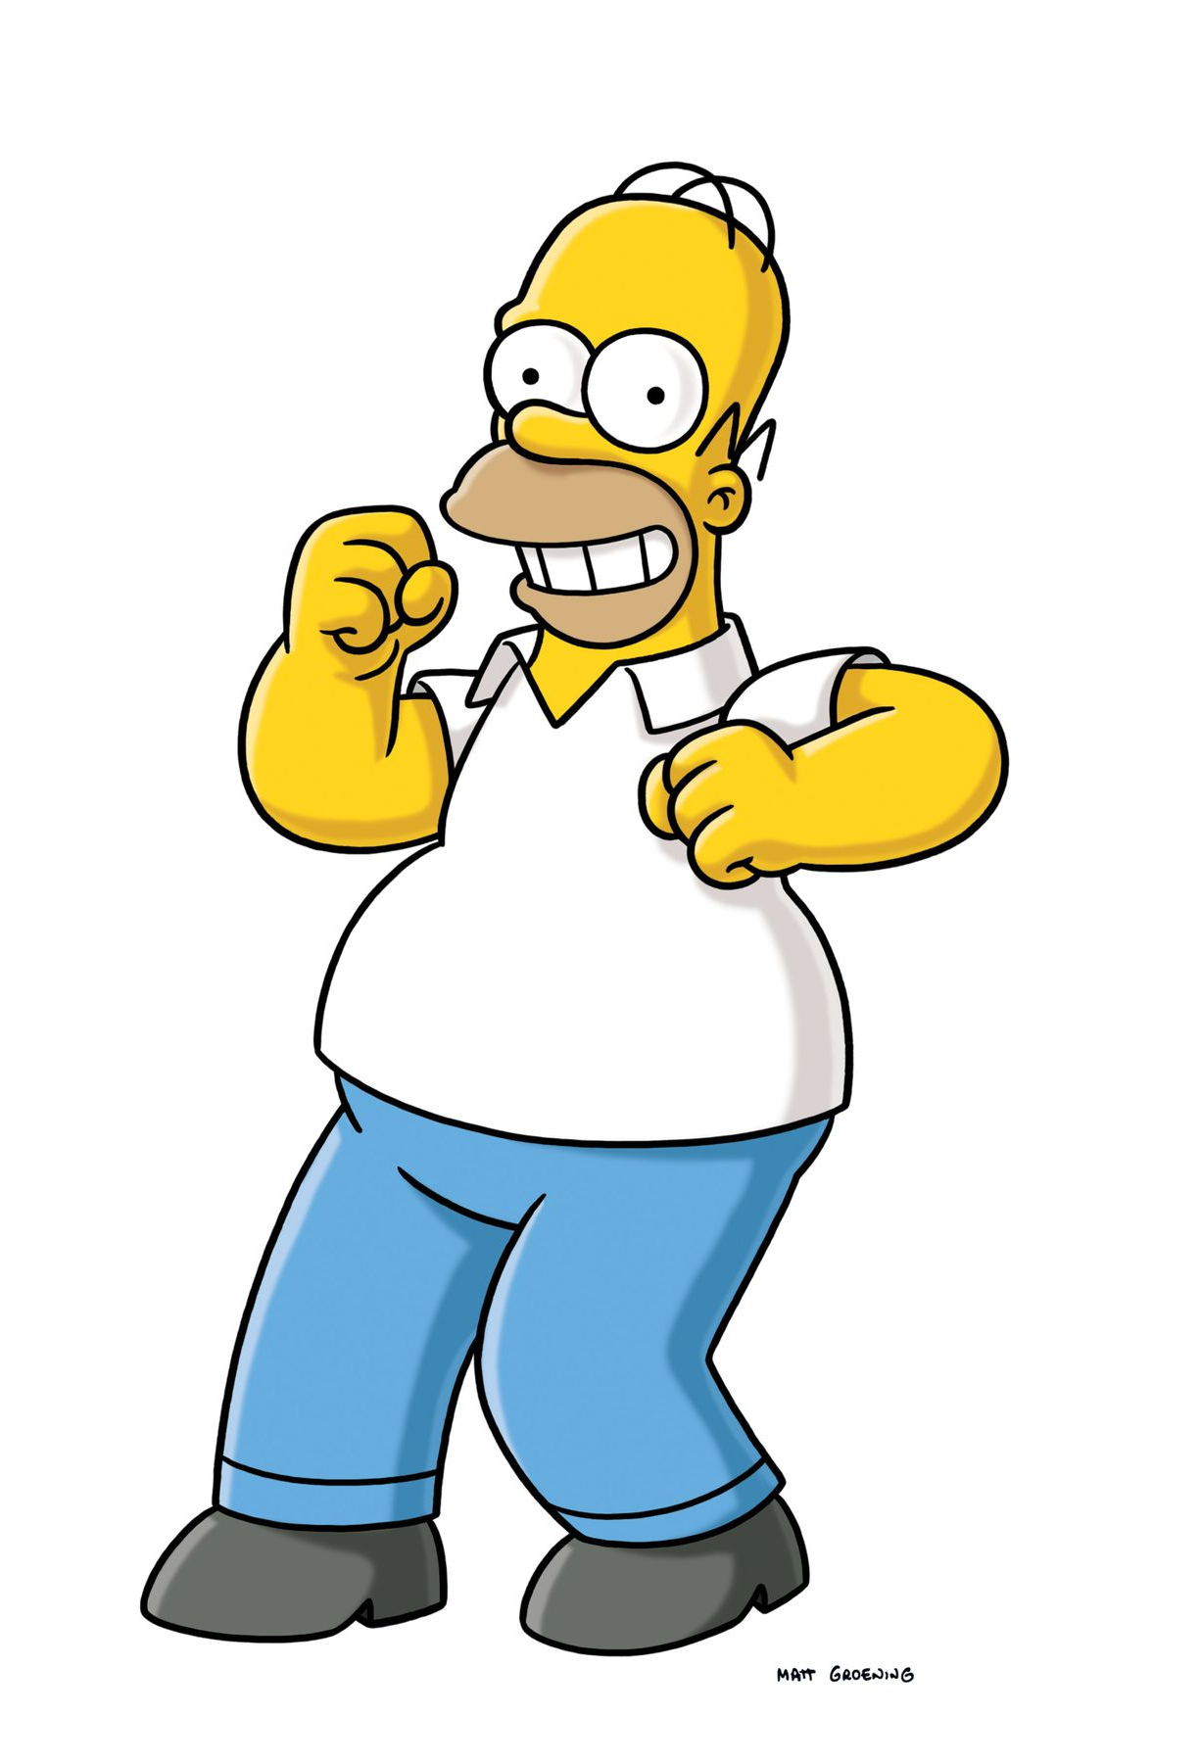
BEHAVIOURAL ECONOMICS
Economic factors
Heuristics and biases
Biases - Illogical behaviours
Hundreds of biases…
“Far from homo economicus, we often seem closer to Homer (Simpson) economicus”
Behavioural Economics: The Basics (Philip Corr & Anke Plagnol)

Slide 15
IDENTIFYING cognitive biases – BASIC APPROACH
Risk aversion
100 physicians
52% vs 28%
Challenges
Alongside appeal / ITT
How would you describe your approach to trying new treatments, using the following scale?
Source: Client study, with results adjusted by +/- 1% (n=100)

Slide 16

A PROBLEM
Factors of which unaware
Unconscious bias
Pain medication study¹
Challenges for quant and qual
1. Hoffman, K.M., Trawalter, S., Axt, J.R., & Oliver, M.N. (2016). Racial bias in pain assessment and treatment recommendations, and false beliefs about biological differences between blacks and whites. Psychological and Cognitive Sciences, 113, 4296-4301.

Slide 17
ADVANCED APPROACH
Over-confidence
RCT / split sample
Own practice vs own behaviour
Challenges
What % of all antibiotic prescriptions written in the last month were clinically justified?
Average scores shown below
(n=50)
(different n=50)
Source: Client study, with results adjusted by +/- 1% (n=100)

Slide 18
SUMMARY
Subtle influences
Heuristics and biases
RCT / split sample

Slide 19
4. Personality psychology
https://theicg.co.uk/recording-of-applications-of-psychology-to-market-research/

Slide 20
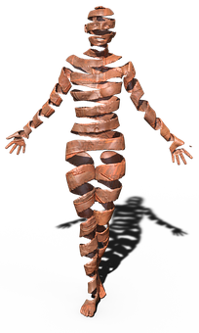
PERSONALITY PSYCHOLOGY
Behave consistently¹
  Distinct
  Stable
  Accurate self-reporting²
  Explain and predict behaviour
1. Leonard, E., & Katsanis, L. (2013). The dimensions of prescription drug brand personality as identified by consumers. The Journal of Consumer Marketing.
2. Kim, H., di Domenico, S., & Connelly, B.S. (2018). Self-other agreement in personality reports: a meta-analytic comparison of self- and informant-report means. Psychological Science.

Slide 21
OCEAN¹ / BIG FIVE – SUMMARY
Spectrum
Heritable³
Reliable⁴
Consistent⁵
TIPI²
HIGH
LOW
Openness to experience
(Inventive/curious vs consistent/cautious)
Conscientiousness
(Efficient/organised vs easy-going/careless)
Extraversion
(Outgoing/energetic vs solitary/reserved)
Agreeableness
(Friendly/compassionate vs cold/unkind)
Neuroticism
(Sensitive/nervous vs secure/confident)
1. An introduction to the five factor model and its applications
5. Why can't a man be more like a woman? Sex differences in big five personality traits across 55 cultures
2. Ten item personality inventory.
3. Heritability of the big five personality dimensions
4. Interpersonal Perception

Slide 22

Personality traits in action – BASIC APPROACH
Accurate, unbiased self-reporting
Ask about traits known to be key
Conscientiousness and Extraversion predict physical activity¹
Segmentations
1. Personality correlates of physical activity: a review and meta-analysis

Slide 23

Personality traits in action – ADVANCED APPROACH
Confirming academic hypotheses?
Trait + attitudinal & behavioural data
“Anticipated regret” predicts health behaviour¹
Regret statements, product behaviours and perceptions
Regret best predicted behaviour
1. Anticipated regret and health behaviour: a meta-analysis

Slide 24
SUMMARY
Explain / predict behaviour
Embrace complexity
Participant unawareness

Slide 25
5. wrap-up and Q&A

Slide 26
CONCLUDING THOUGHTS
BS highly relevant – but two challenges
Complexity
Participant unawareness
Change models, BE, personality

Slide 27

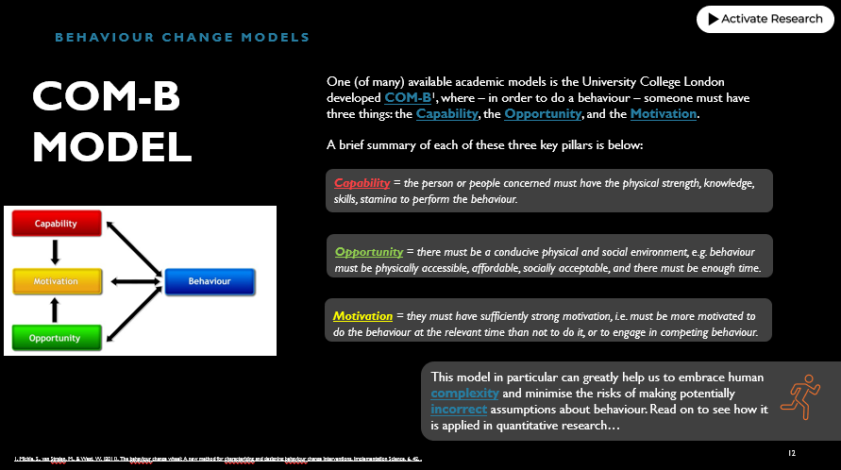
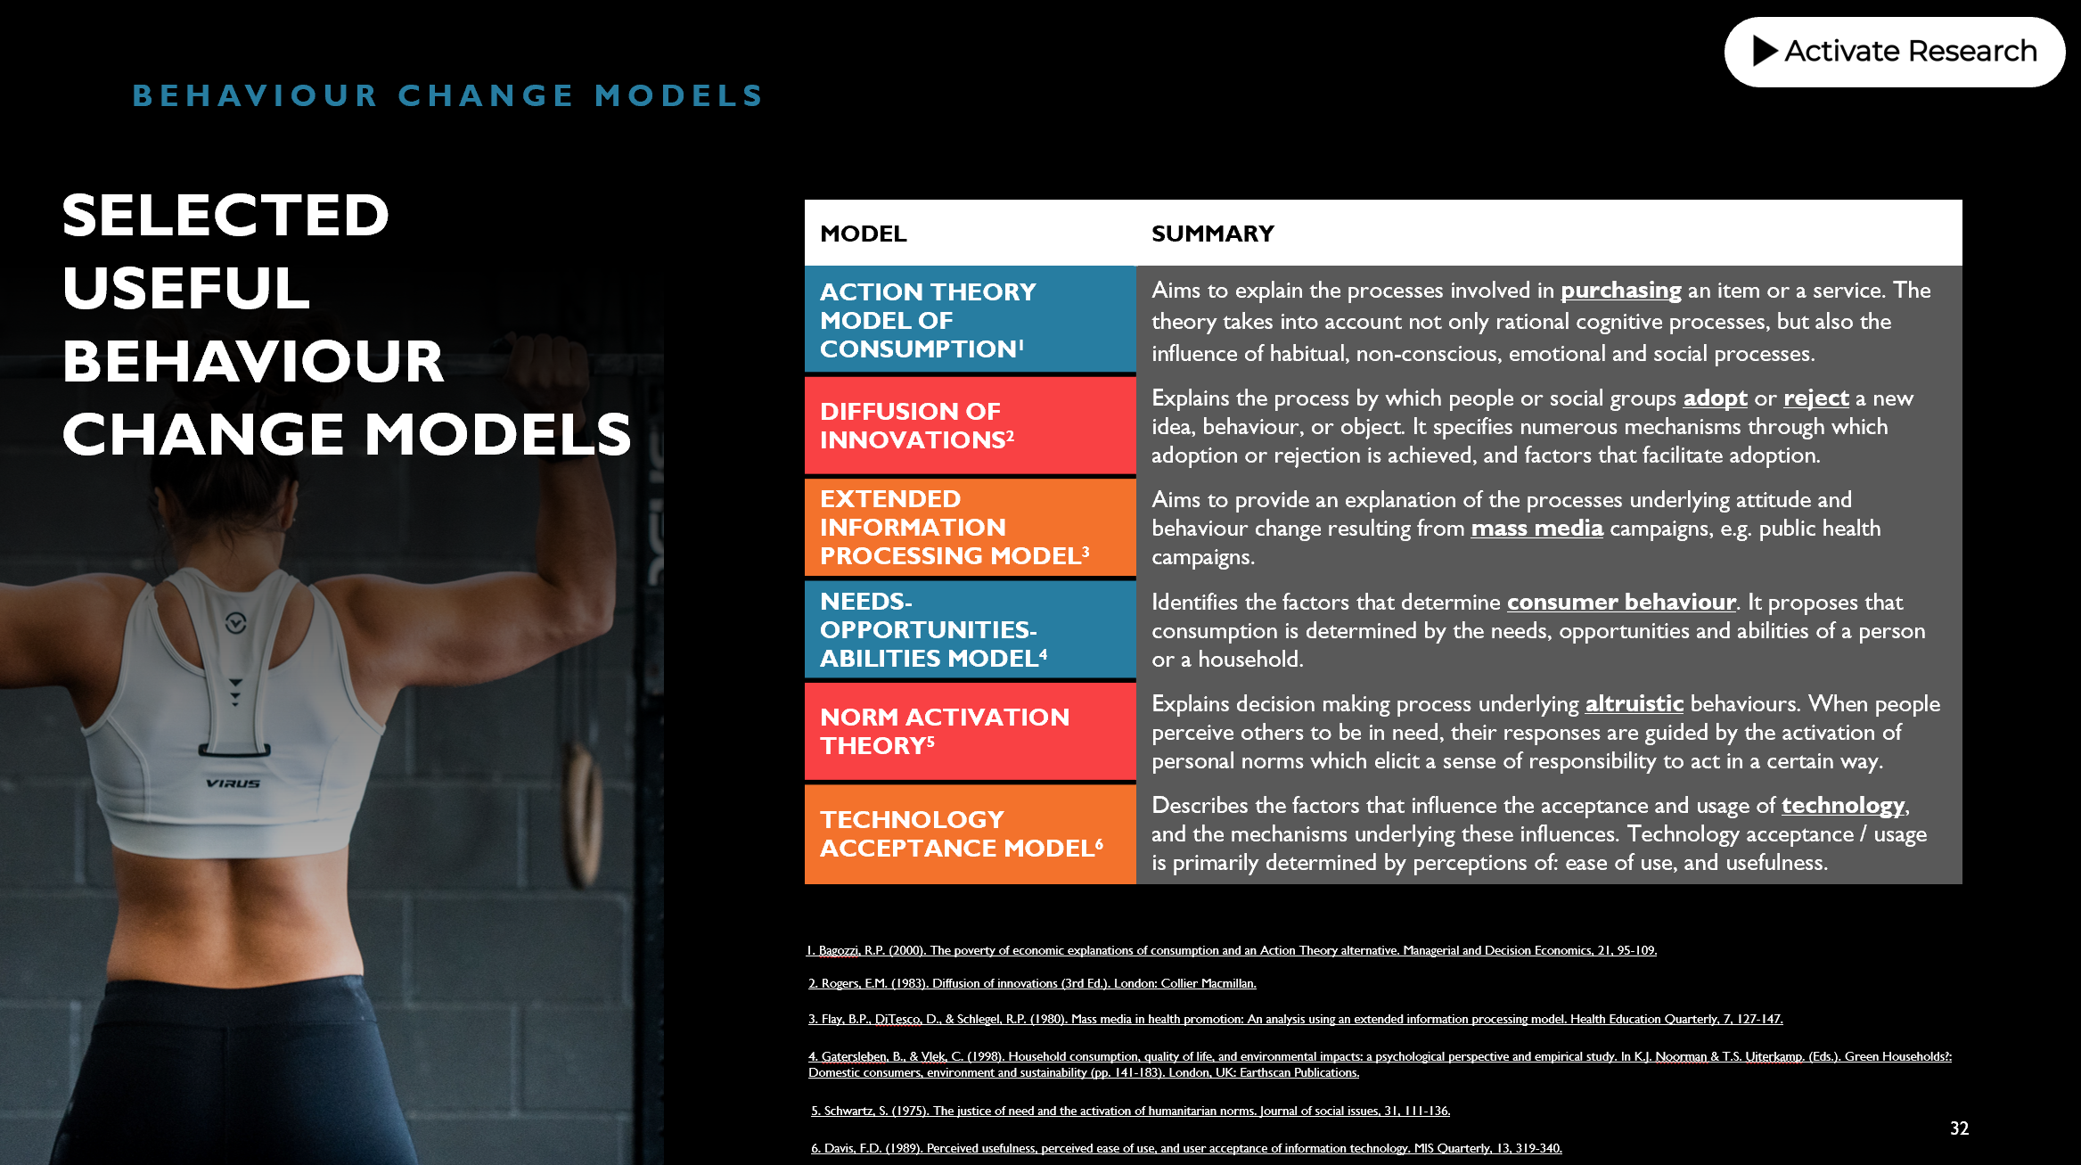
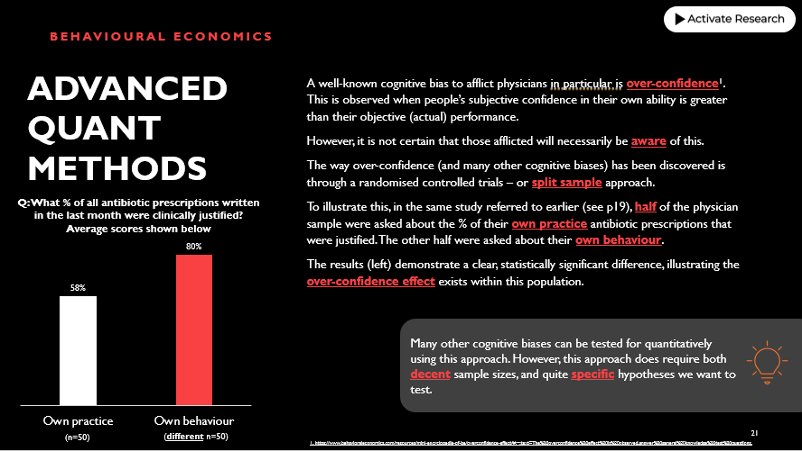
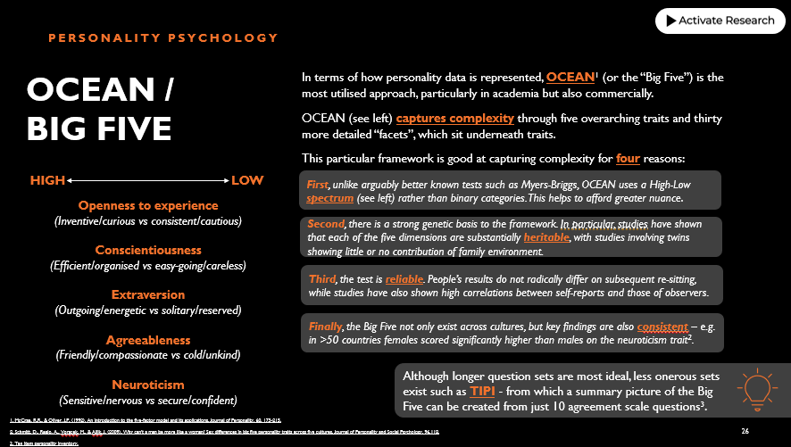
FULL GUIDE AVAILABLE – WITH ADDITIONAL INSIGHTS AND APPROACHES
FOR MORE DETAILS AND TO ORDER YOUR FREE COPY GO TO https://www.activate-research.com/quantitative-research-guide

Slide 28
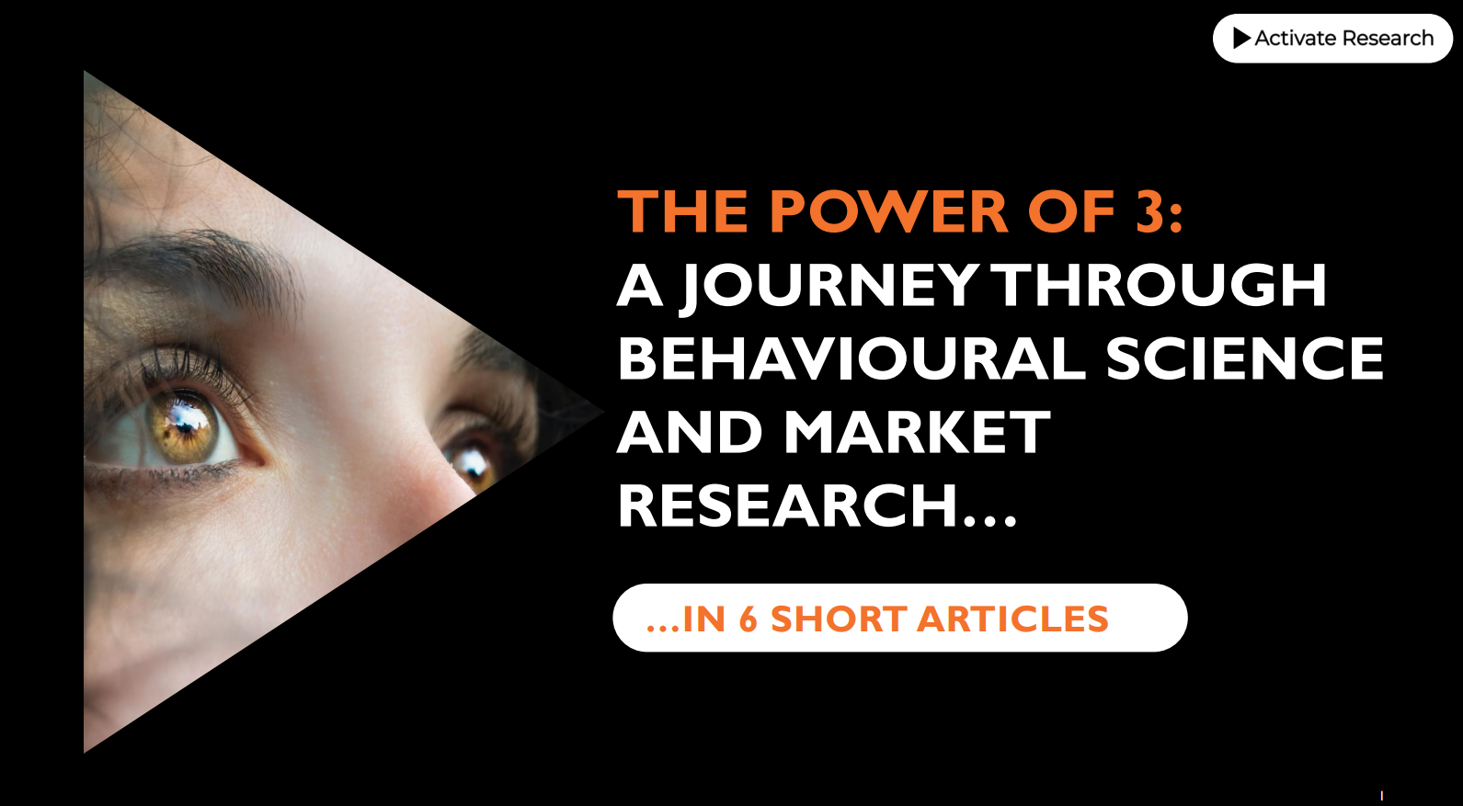
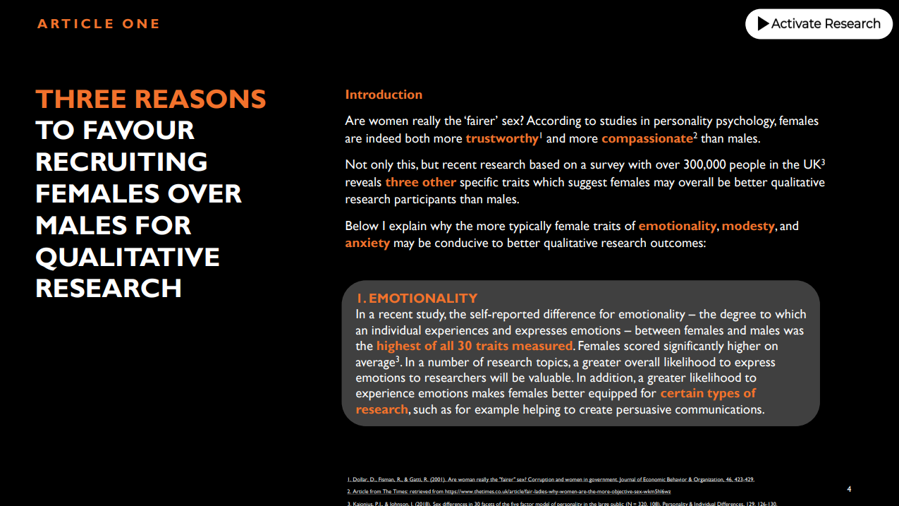
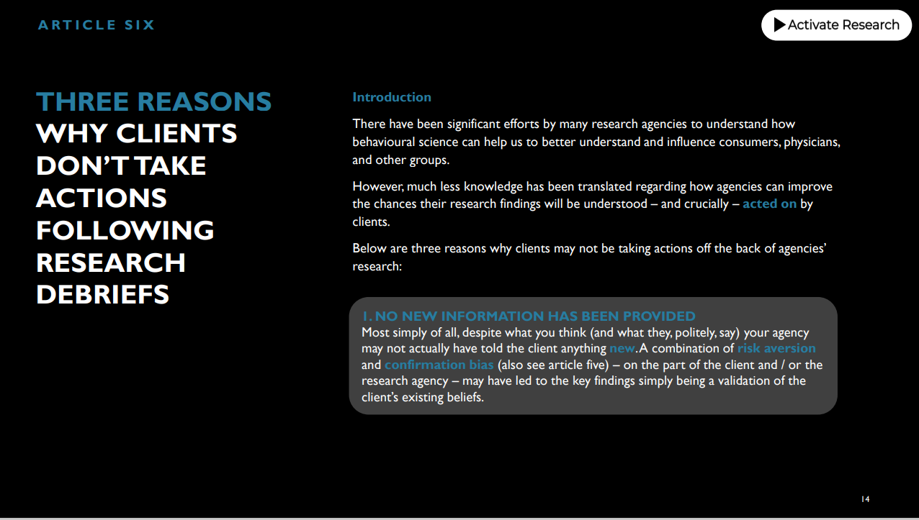
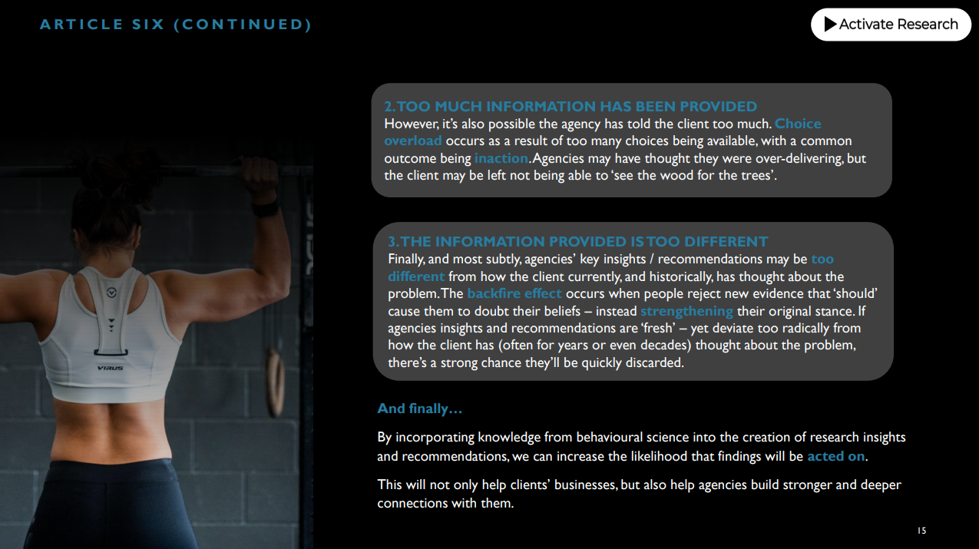
FOR SOMETHING A LITTLE LIGHTER…
FOR MORE DETAILS AND TO ORDER YOUR FREE COPY GO TO https://www.activate-research.com/behavioural-science-and-mr

Slide 29
ANY QUESTIONS?

