Slide 1
Data Visualisation
An Art or a Science?
ICG Network 9th February 2022
Andrew Le Breuilly – Arrowstream Analytics
Colin Wojtowycz – Datawoj

Slide 2
Defining Data Visualisation
Perceiving - what does the data show?
Interpreting - what does it mean?
Comprehending - what does it mean to me?
"The representation and presentation of data to facilitate understanding”.
Notes:
Our goal is to provide the greatest degree of understanding with the least amount of effort. Steve Wexler (2022), The Big Picture.
What does it show?
Big, medium or small?
Relationships?
Comparisons?
Trends?
What does it mean?
What’s good or bad?
Meaningful or significant?
Unusual or expected?
What does it mean to me?
Key messages?
What have I learnt?
What actions need to be taken?

Slide 3





Making sense of your sight
Iconic memory
Short term memory
Long term memory
© 2023: Arrowstream Analytics Ltd and DataWoj Ltd. All rights reserved
Notes:
The process:
Iconic memory – this is where we process sensory information. We see objects broken down by their components such as lines, colour intensity, hue
Our short term memory- then stores the information in our short term memory where we make sense of it.
We can store in the region of 3 to 8 things in our short term memory at one time.
If some thing else enters our short term memory then our brain either moves some of the short term memory to our long term memory or we just forget it.
Long –term memory links our memories from the past. It is where we create stories based upon what we have learnt in the past.
When you want to show people data or complex information, we want to help them as much as possible.
Therefore we want to use the iconic memory. To do this we can use something called pre-attentive processing.

Slide 4
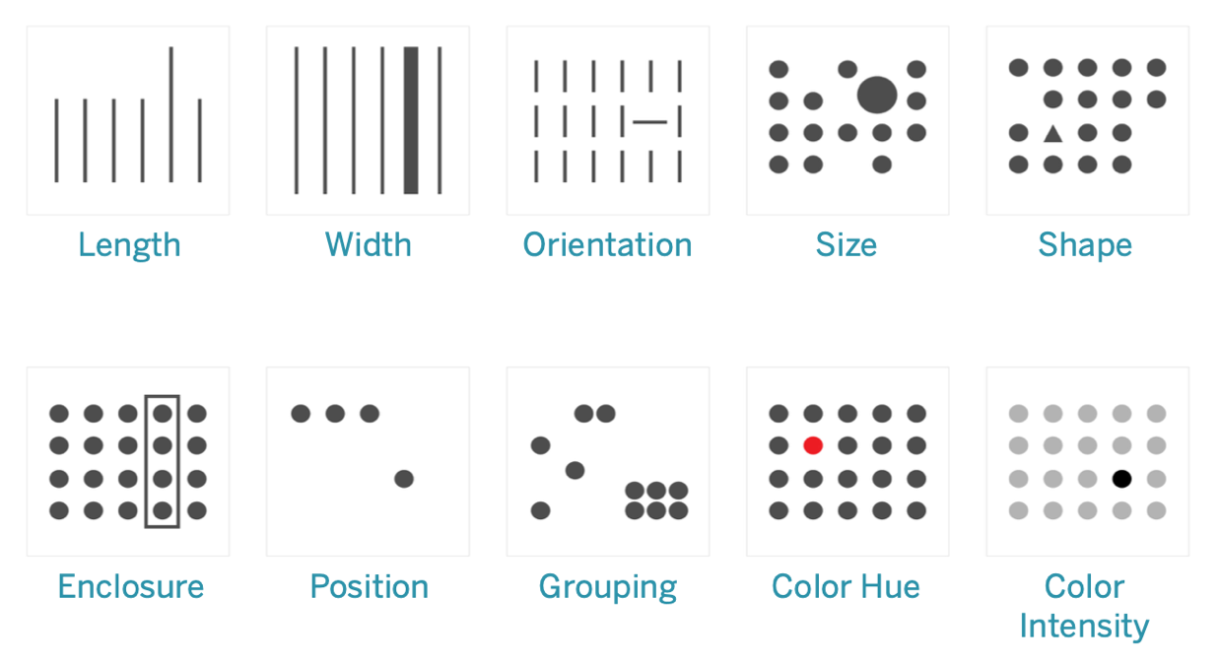
Pre-attentive attributes
© 2023: Arrowstream Analytics Ltd and DataWoj Ltd. All rights reserved
Notes:
These are some of the basic visual properties that can be defined as pre-attentive i.e. length, size, shape, position and colour etc.
Processed in our iconic memory without our conscious thought
Iconic memory tuned to pre-attentive attributes.

Slide 5
Attentive Processing
43242349234254587872903802842750943850128070843250287435083247092834079098432750984327408437528364123648932749
© 2023: Arrowstream Analytics Ltd and DataWoj Ltd. All rights reserved
Notes:
An exercise in visual processing...
How many number fives appear in the picture?
Place your answers in the chat please…
Your brain has to work look at each number in turn.
This is your short term memory working to process the information attentively.

Slide 6
Pre-attentive Processing
43242349234254587872903802842750943850128070843250287435083247092834079098432750984327408437528364123648932749
© 2023: Arrowstream Analytics Ltd and DataWoj Ltd. All rights reserved
Notes:
In this view we have faded out all the non important numbers so the 5s stand out
Exact same data as before but using pre-attentive attributes to help answer the problem
This is your iconic memory being employed to deal with it sub-consciously
Hopefully you found that quicker and easier?

Slide 7
1. How much bigger is circle B compared to circle A?
Answer = 16
?
1
A
B
© 2023: Arrowstream Analytics Ltd and DataWoj Ltd. All rights reserved
Notes:
Another game.
Or, it is 16 if the area is what we mean by size. The linear difference is 4 times larger (ie the diameter).
Most people perceive the difference to be between 10 and 13 as the eye-brain system tends to slightly underestimate areas relative scales.
The lesson is that you have to be very careful when using area in charts as there is a great deal of danger of misleading about relative size.
Some of the worst misleading charts occur because of this issue (and some exaggerate it further by using 3-D effects).

Slide 8
Are the sales of Pinot Grigio smaller, larger, or the same as Sauvignon Blanc?
2A Answer = Larger
2B Answer = Larger
© 2023: Arrowstream Analytics Ltd and DataWoj Ltd. All rights reserved
Notes:
Decision Sciences Practice
08/02/2023
Data Visualisation
8
One more game...
These charts show breakdowns of sales by type of wine
It is difficult to compare pie segments that are of similar size based upon area alone
For this reason that pie charts are considered bad
Our brains are much better at judging comparative length than comparative area
Hopefully you find it easier to judge the difference using the bar chart?

Slide 9
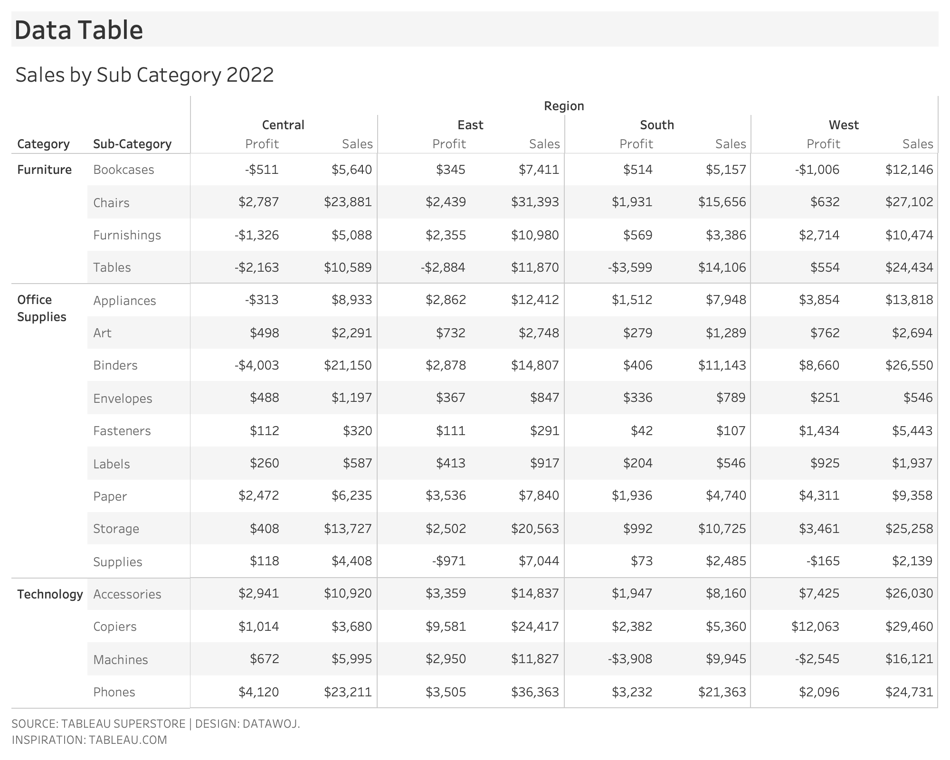
Tabular data
© 2023: Arrowstream Analytics Ltd and DataWoj Ltd. All rights reserved
Notes:
How can we use this knowledge of visual processing in our chart design?
Data tables are still very popular
This table presents sales and profit data by product category / sub category by region
As we saw with our attentive processing they require a high brain effort to understand the data.

Slide 10
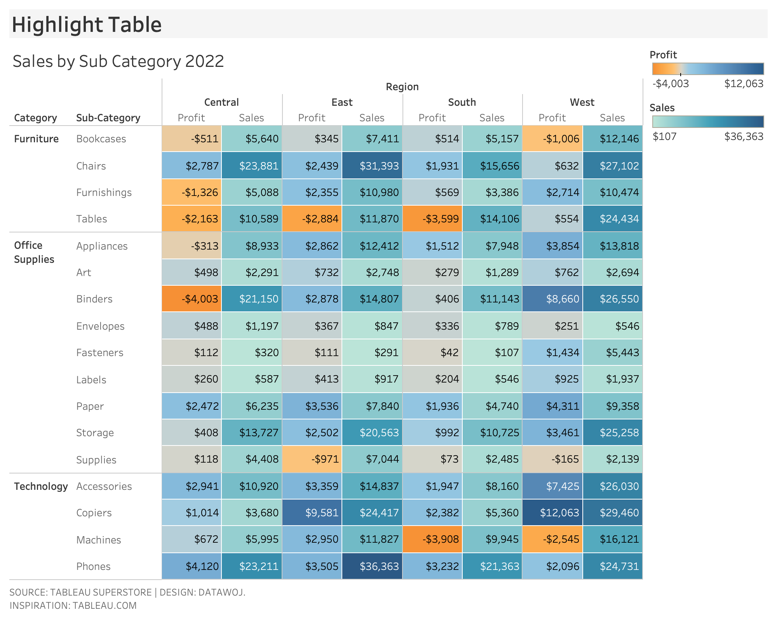
Highlight Table
© 2023: Arrowstream Analytics Ltd and DataWoj Ltd. All rights reserved
Notes:
Highlight tables are known as the gateway into data visualisation
By applying pre attentive elements such as colour we can highlight at a glance where sales or profit are high or low
However, there is still quite a lot of visual information to process
How can we make it even easier to understand?

Slide 11
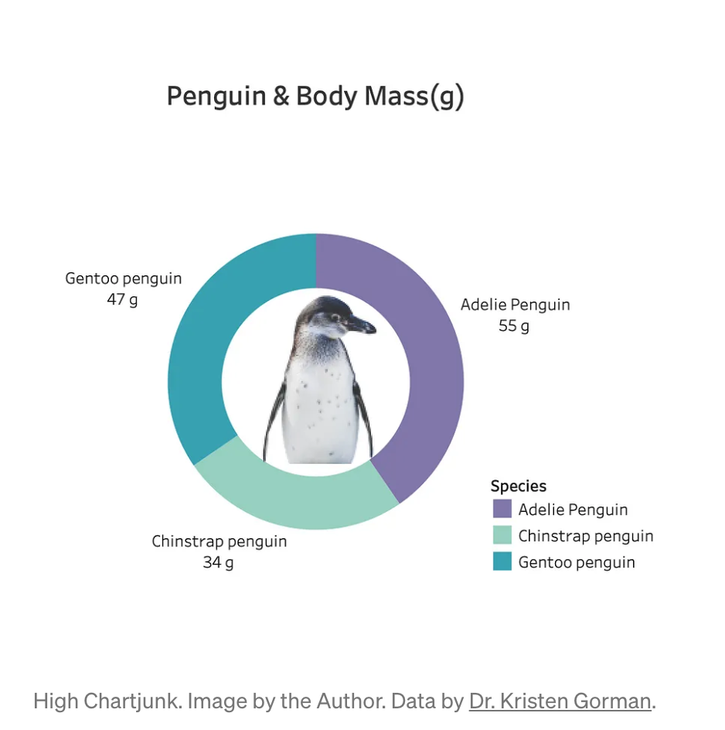
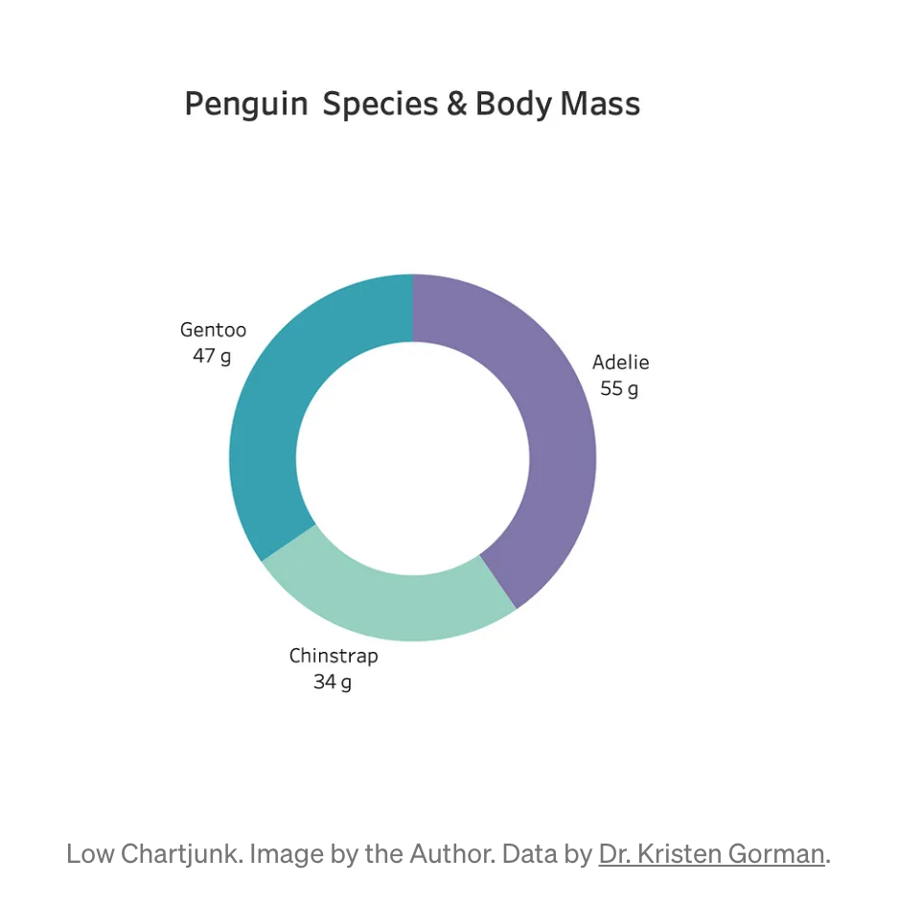
Data Ink Ratio
“The amount of data ink divided by the total ink required to print the graphic” Edward Tufte, 1983
Notes:
Data ink ratio:
“The amount of data ink divided by the total ink required to print the graphic”
Edward Tufte, (1983), The Visual Display of Quantitative Information.
Remove non data ink – i.e. those elements which don't add new information to the visual understanding
Remove background elements within reason such as gridlines or make them visible enough to serve purpose but not distract from relevant information.
Remove chart junk refers to all unnecessary visual elements which distract the user.
For example… Removing the penguin – although I think he is quite cute!
Remove redundant data ink within reason – i.e. use less chart ink e.g. legends, labels etc.
For example…
We can remove colour legend to show the same information in the penguin chart on the right as the left.
Remove (G) from title
Benefits:
Clear message - easier to consume by audience
Save time - readers get message quicker
Save space - occupy less space, re-size easier.

Slide 12
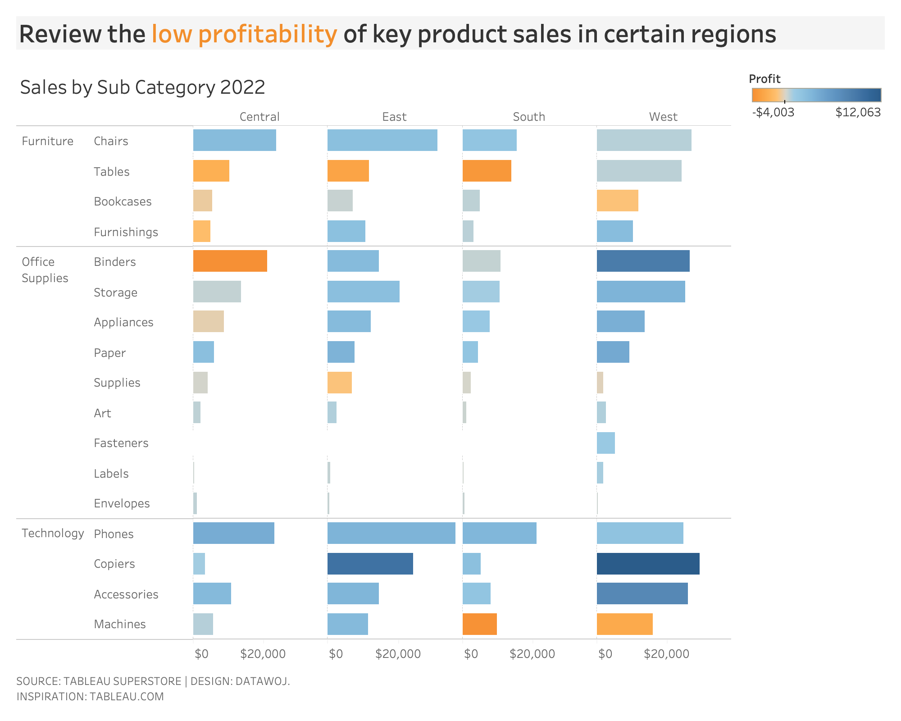
Designed dashboard
© 2023: Arrowstream Analytics Ltd and DataWoj Ltd. All rights reserved
Notes:
Let’s apply some more pre attentive attributes to make it easier to understand patterns
Re-designing the table into bar charts shows sales differences by length
Profit can be applied as colour – removing the need for two colour legends
Removed gridlines and data labels
Maximising our data ink ratio so the data is shown more clearly
This is much easier to understand than a table.

Slide 13
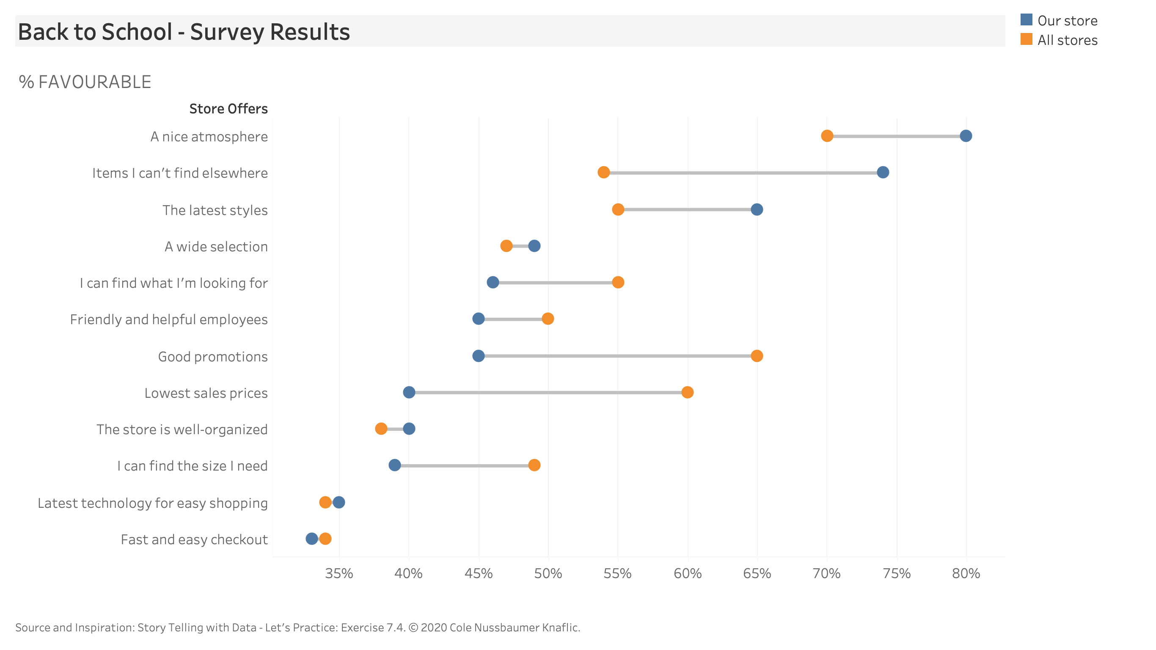
Mind the gap
© 2023: Arrowstream Analytics Ltd and DataWoj Ltd. All rights reserved
Notes:
Let's move on from the science to the artistic side
This chart shows a customer survey for a clothes shop
The coloured dots compare our store to all other stores in terms customer satisfaction with store offers
We are most interested in the gap between how our store performs and all the other stores perform
How can we apply some artistic re-design to make it clearer what the issues are?

Slide 14
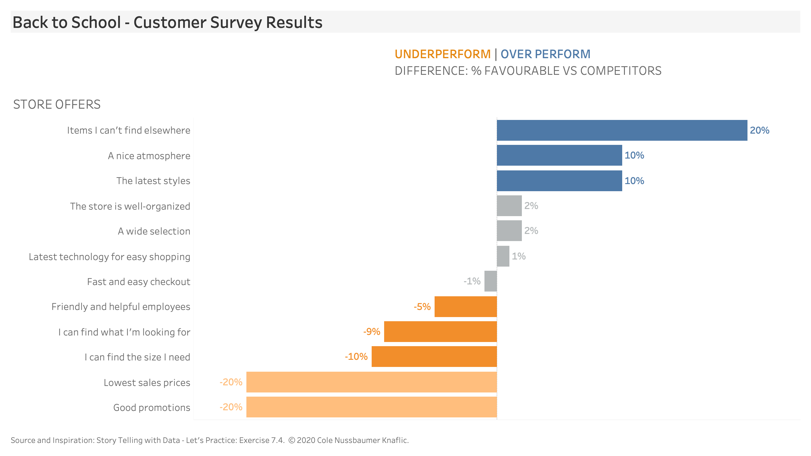
The art of design
Notes:
This chart design focuses upon the difference between our store and others as that is what we are most interested in
It uses a diverging bar chart to show that difference
Colour is use to show over or under performance for each offer.

Slide 15
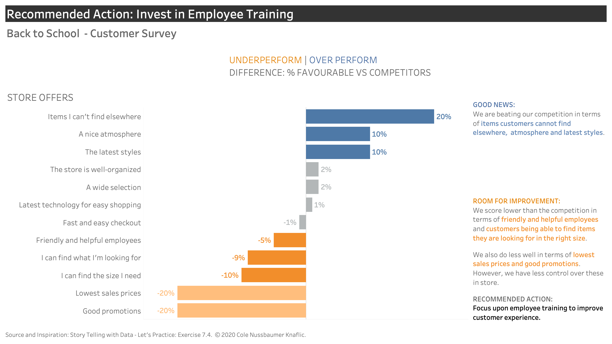
The art of storytelling
© 2023: Arrowstream Analytics Ltd and DataWoj Ltd. All rights reserved
Notes:
Can we tell an engaging story with some clear call to actions?
Engaging stories have a plot, followed by tension relating to a problem that needs to be solved
Finally a recommended solution of how to resolve the issue and restore balance
Note the use of colour to highlight issues for improvement
Note the use of text to highlight recommended actions.

Slide 16
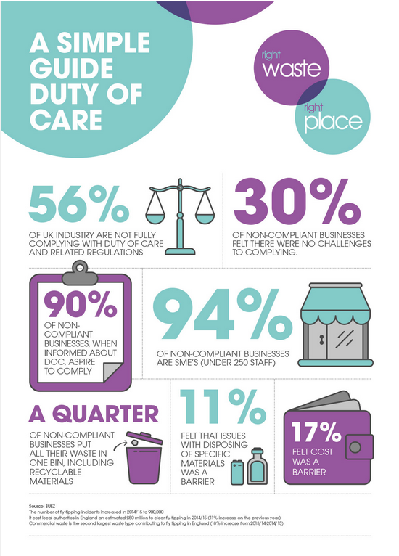
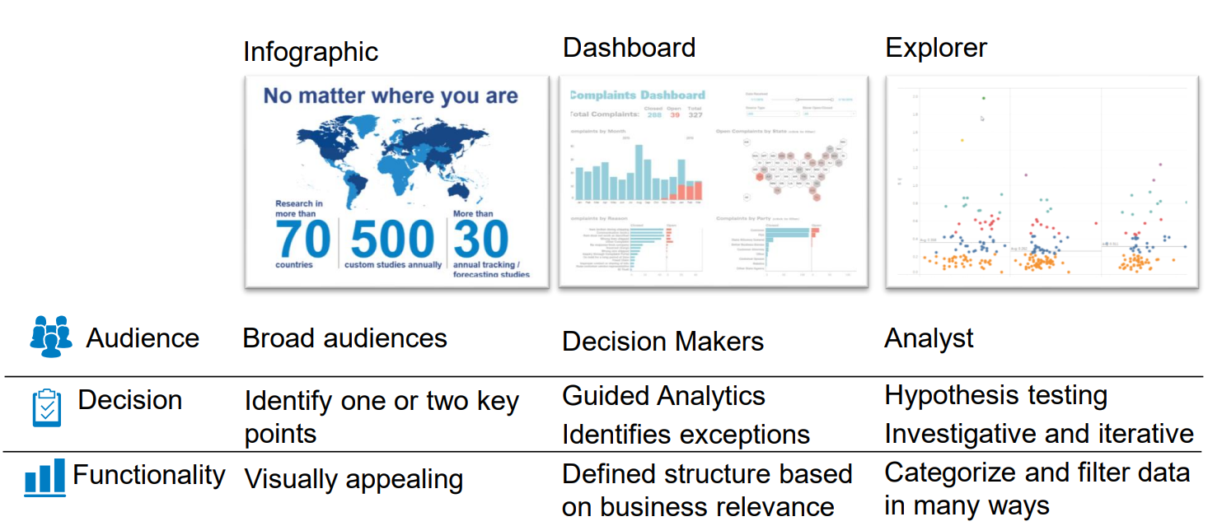
Different types of visualisation need different approaches
Infographic
Dashboard
Explorer
Audience
Broad
Decision makers
Analyst
Decision
Identify one or two key
points
Guided analytics
Identify change and exceptions
Hypothesis testing
Investigating and iterative
Functionality
Visually appealing
Defined structure based on business relevance
Categorize and filter data in many different ways
Infographic example: https://www.toastdesign.co.uk/services/infographic-designers/
Copyright: Arrowstream Analytics Ltd and DataWoj Ltd

Slide 17
Encourage insight with guided analytics
Modular approach to creating intuitive, insightful and scalable dashboards
Intuitive – Simple enough for new users to immediately become familiar and understand
Insightful - Prescribe key information but still allow users to interactively pursue deeper insights
Scalable – Provide good performance at all levels of analysis and irrespective of data volumes.
Intuitive
Scalable
Insightful
© 2023: Arrowstream Analytics Ltd and DataWoj Ltd. All rights reserved

Slide 18
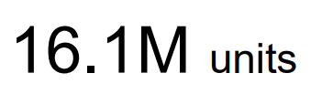
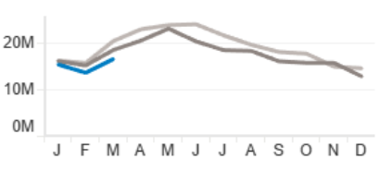
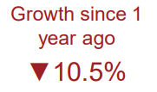
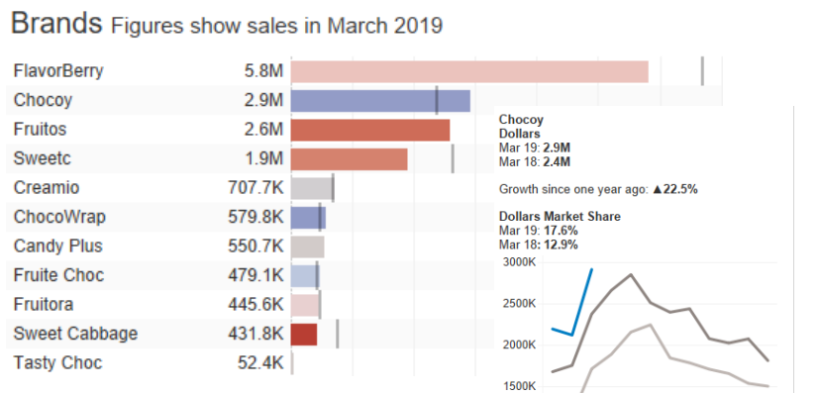
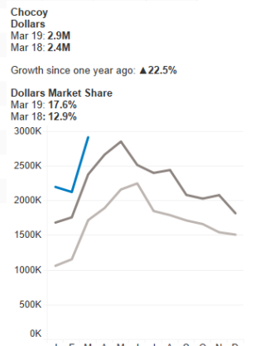
A worked example
Use a BAN to show the latest KPI
Highlight the change from a year ago
Display a sparkline to show how the trend has changed over time
Breakdown of the most important dimension of the data
Use colour to indicate what you need to look at first
Create intuitive tooltips to help the user get more understanding from the data
© 2023: Arrowstream Analytics Ltd and DataWoj Ltd. All rights reserved

Slide 19
Skills required to create a great dashboard
Business knowledge
Dashboard creator
Dashboard designer
© 2023: Arrowstream Analytics Ltd and DataWoj Ltd. All rights reserved

Slide 20
One page dashboard design
Objective/Audience
Key comparisons
Data
Style
Filters
Dimensions
Measures
Business Logic
© 2023: Arrowstream Analytics Ltd and DataWoj Ltd. All rights reserved

Slide 21
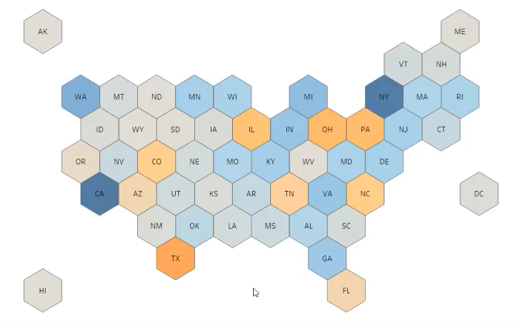
OPDD – worked example
Objective/Audience
Key comparisons
Data
Style
Senior management
To understand the market share of the chocolate bar market
Compare the latest month to the previous month, compare brands
Changes over time seasonality
Point of sale data
Brand catalogue
Use the brand guidelines
1000x800px screen,
Mobile friendly version
Filters
Dimensions
Region
Manufacturer
Time intervals
$25.5M
Growth since 1 year ago
▲ 3.3%
Regions
Brands
Time intervals
Measures
Business Logic
Units sold
Revenue
% change
CAGR
In February 2019 we changed system so no data exists for that period.
Some brands have been acquired by different manufacturers over time.
Response Base: n = X. Based upon response to: Q1. Interviewer: Which region are you distributing in?
Source: KSA Concept Questionnaire.
© 2023: Arrowstream Analytics Ltd and DataWoj Ltd. All rights reserved

Slide 22
A recap…
In this webinar we have:
Demonstrated the principles of how our brains perceive images and learnt which are most appropriate when showing data.
Introduced tools, like the data ink ratio, to ensure that we show the data as clearly as possible.
Uncovered the design considerations required for building dashboards
Provided a simple tool for designing new visualisations.

Slide 23




So… Is Data visualisation an art or a science?
Andrew Le Breuilly
Andrew@arrowstream.co.uk
Colin Wojtowycz
colin@datawoj.co.uk
Notes:
Colin:
My thoughts are that the science helps us to show our audience what we want them to know...
The art is to design charts that leverage that knowledge to maximise insight and minimise audience effort
Then through story telling to tell our audience what we want them to do or act.

