Slide 1
Free hotel foyer / working spaces in central London
Fellow ICGers,
Can anyone recommend a good location for a mid-morning working meeting in central London?
Just for two people for a couple of hours.
Don't really want to have to pay for a meeting room or chance it finding table space in a coffee shop.
Hoping that someone might have a good idea….

Slide 2
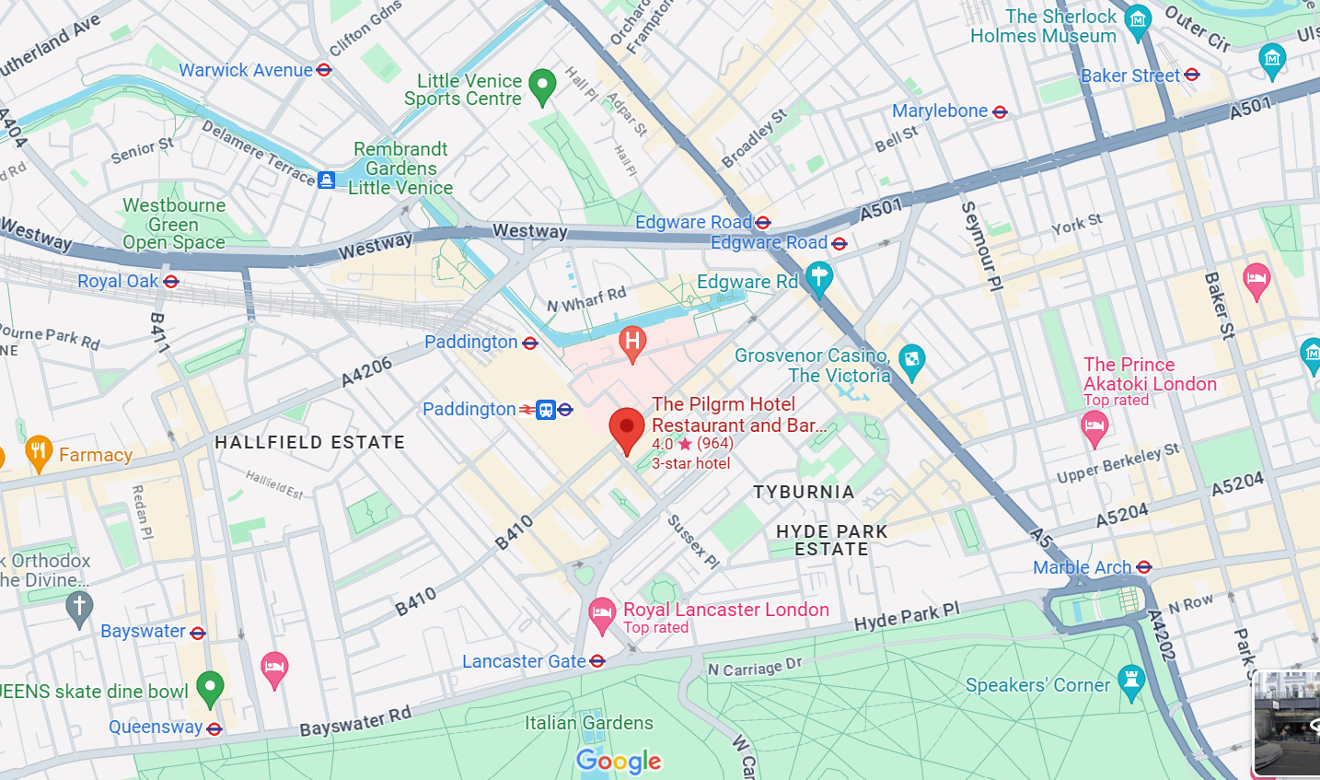
The Pilgrim Hotel at Paddington https://thepilgrm.com/
ICGer notes: There's a great one in Paddington for anyone who comes in by train from the West. They do all day brunch and it is really quiet during the day, lots of plug points and the staff let you get on with it.
The Pilgrim
25 London Street
London
W2 1HH

Slide 3
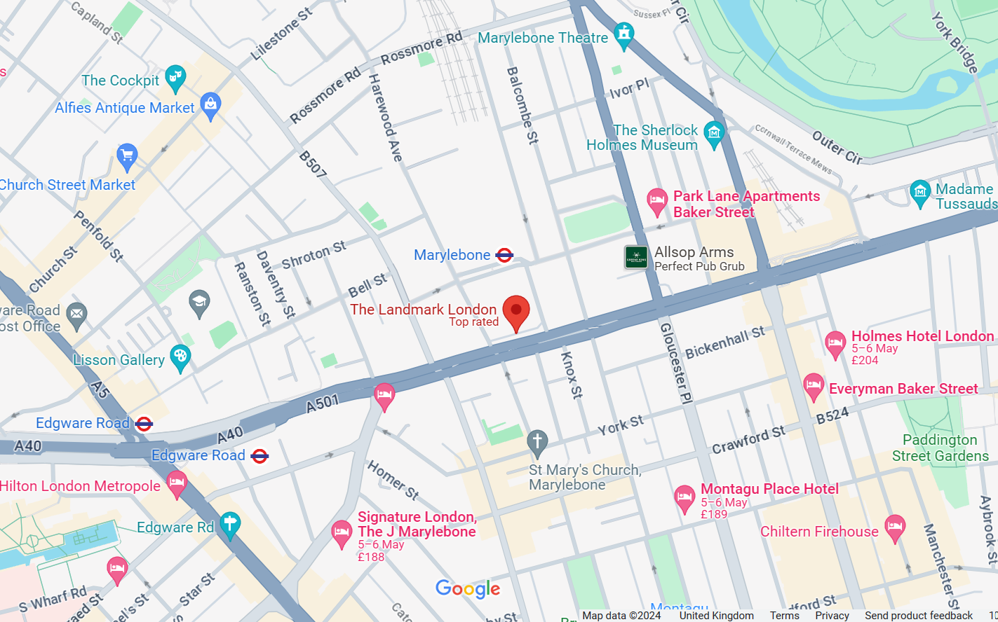
Lansdown by Marylebone https://www.landmarklondon.co.uk/
ICGer notes: 5* hotel. The main coffee table can be a min charge of £12 but worth it for such a lovely space - can easily stay there 2-3hrs and there are a few table around where you can just have coffee. The Landmark right by Marylebone has a great bar/lounge. I've had meetings there and just bought drinks
The Landmark London
222 Marylebone Road
London
NW1 6JQ

Slide 4
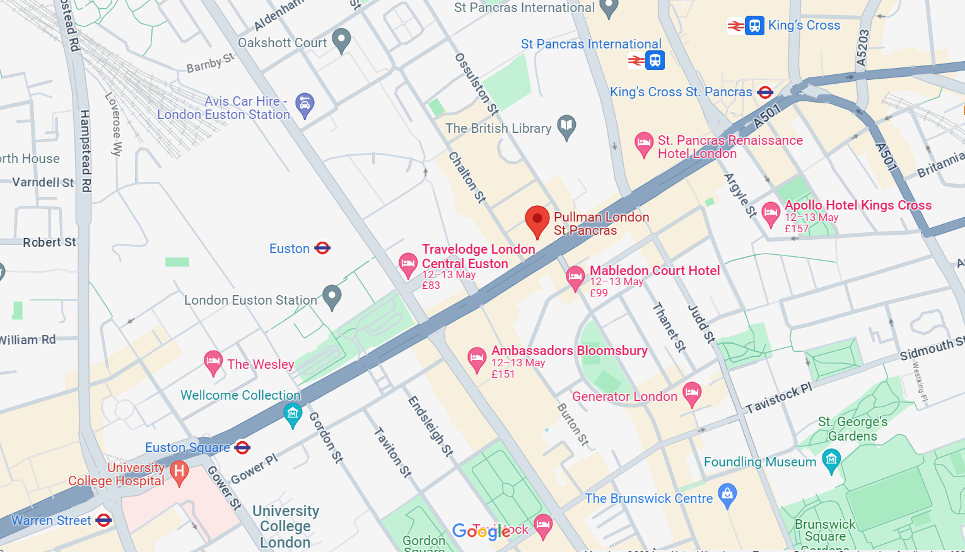
Pullman Hotel St Pancras https://www.pullmanlondonstpancras.com/
ICGer notes: You could try the ground floor space at the Pullman St Pancras hotel next to the British Library
Pullman London St Pancras
100 - 110 Euston Road
London
NW1 2AJ

Slide 5
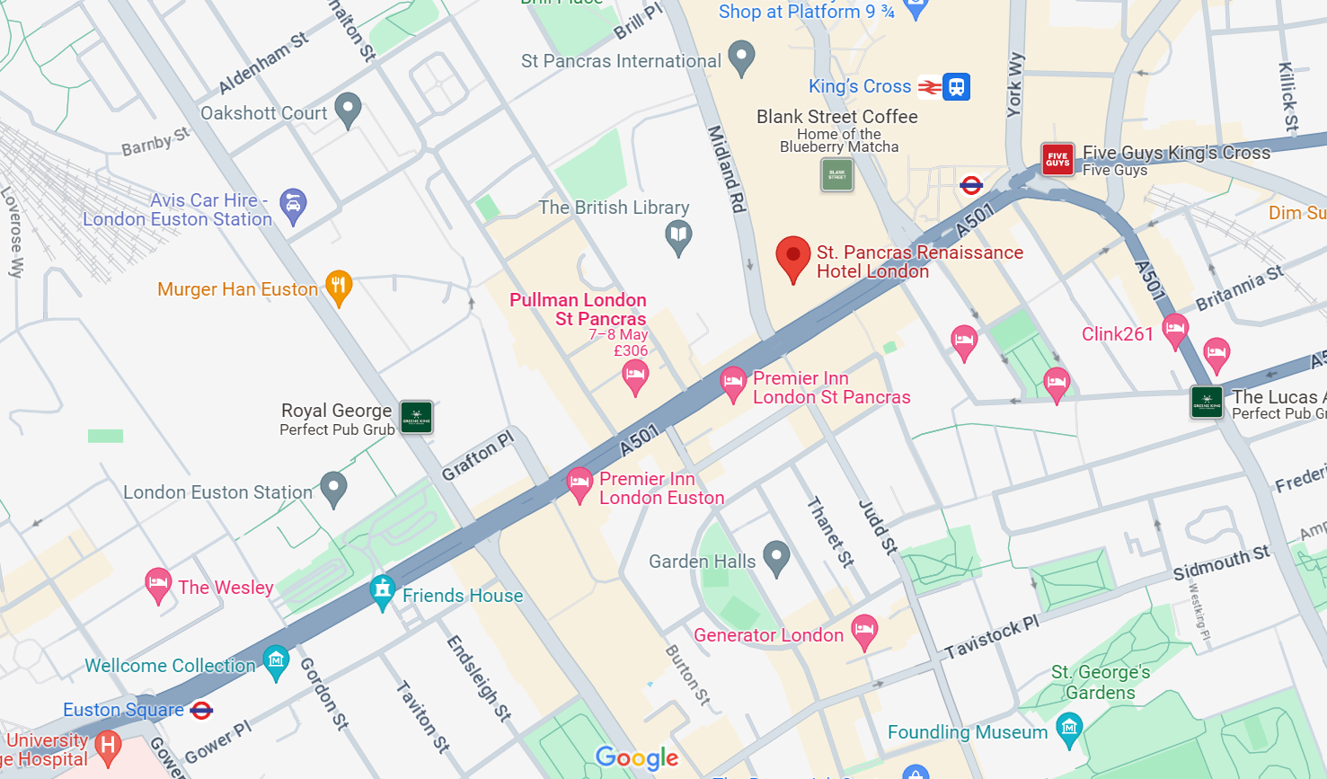
Renaissance Hotel St. Pancras https://www.marriott.com/en-us/hotels/lonpr-st-pancras-renaissance-hotel-london/overview/?scid=f2ae0541-1279-4f24-b197-a979c79310b0
ICGer notes: You could try the foyer of the Renaissance St Pancras hotel (fallback: the champagne bar on the first floor!)
St. Pancras Renaissance Hotel
Euston Rd
London
NW1 2AR

Slide 6
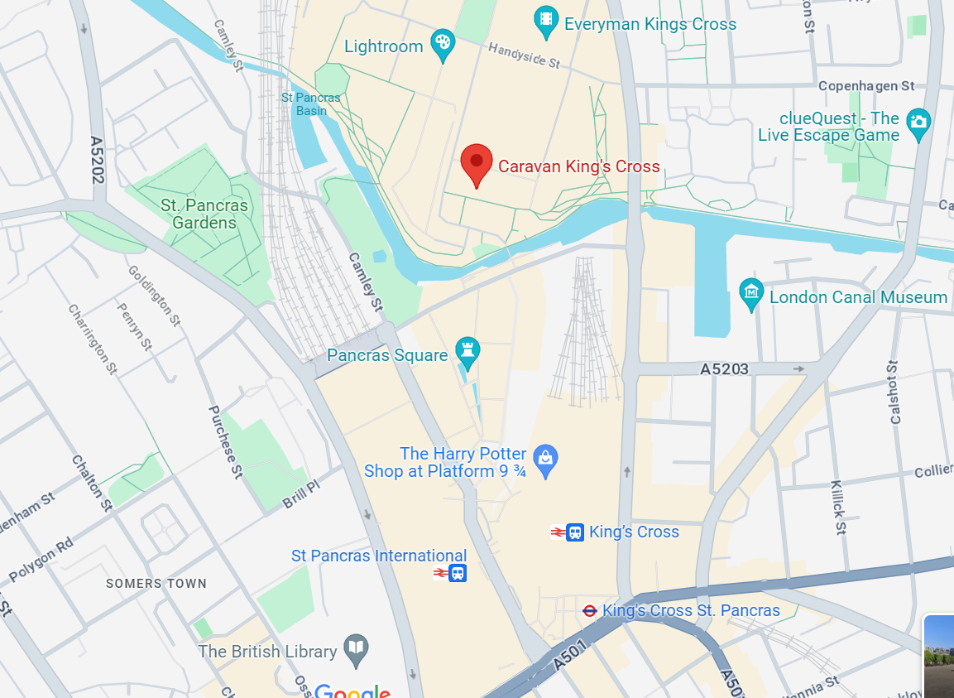
Caravan at Kings Cross https://caravanandco.com/pages/kings-cross
ICGer notes: Caravan Restaurant near Kings Cross, the back has some quite area, and is great for meetings. Tends to be quiet until around 5pm but then it gets busy.
Caravan
1 Granary Square
London
N1C 4AA

Slide 7
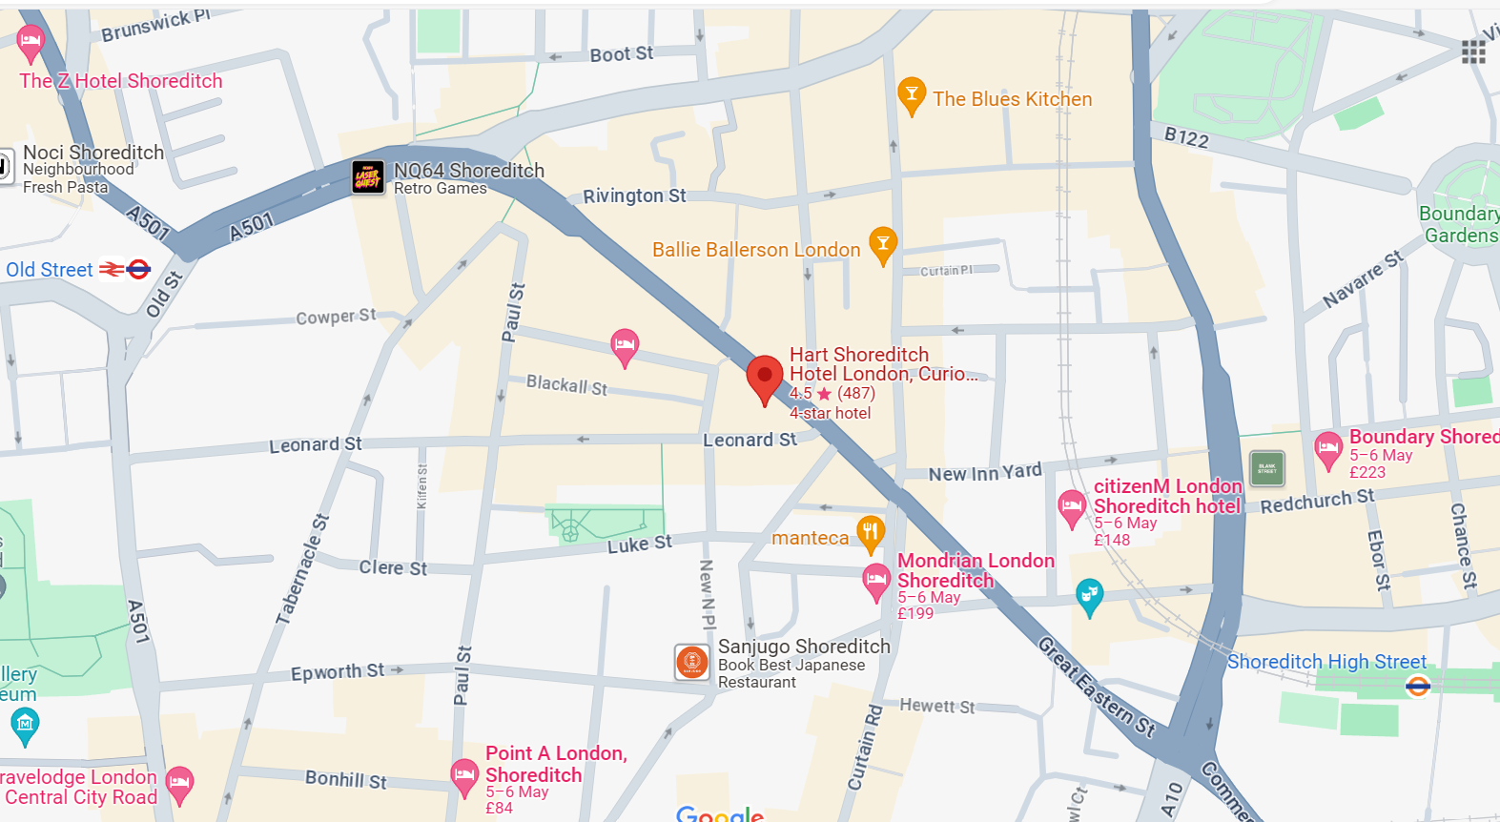
Hart Shoreditch Hotel https://www.hilton.com/en/hotels/lonsdqq-hart-shoreditch-hotel-london/?SEO_id=GMB-EMEA-QQ-LONSDQQ
ICGer notes: Hart Hotel near Old Street - it's cosy and usually pretty quiet, and the decor makes for a relaxed atmosphere.
Hart Shoreditch Hotel
61 - 67 Great Eastern St
London
EC2A 3HU

Slide 8
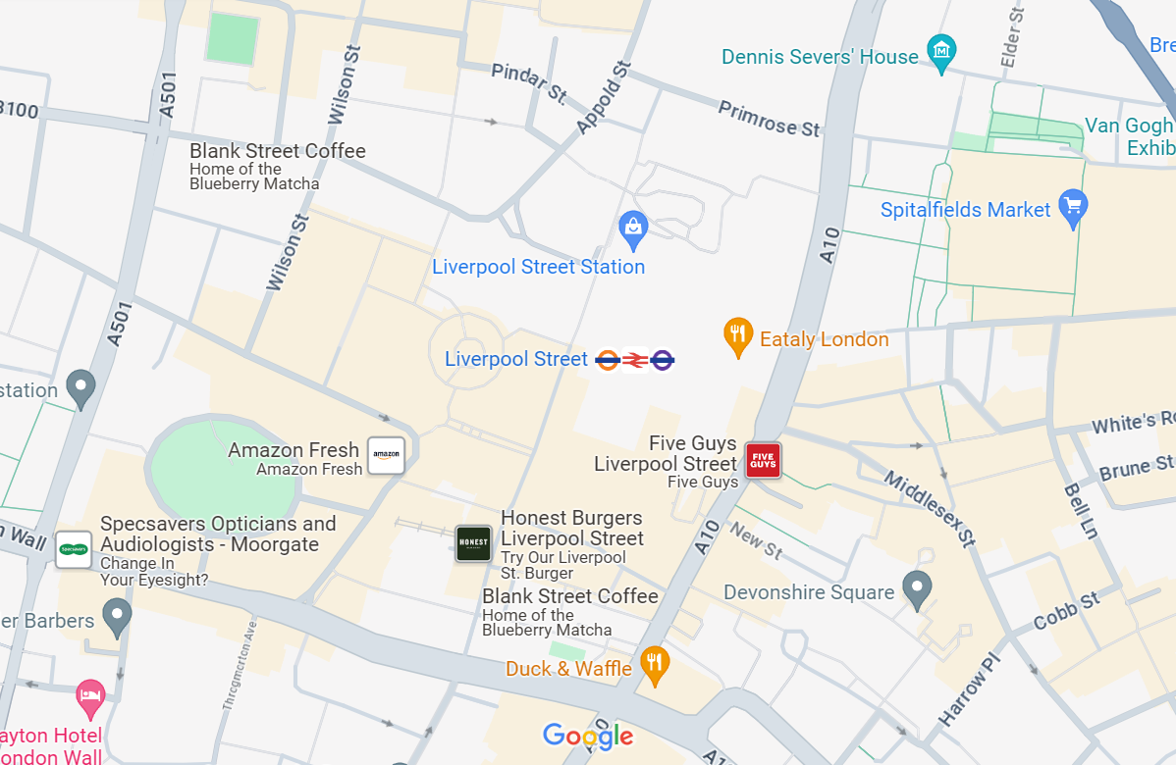
Coco Di Mama Liverpool Street Station https://www.cocodimama.co.uk/locations/london-liverpool-street-station
ICGer notes: I'd recommend Coco Di Mama at Liverpool Street station), as there's power sockets by every table and outside of peak hours (8-9am and 12-1:30) it's pretty quiet. Only downside is it can get quite chilly on a windy day as it's by the Broadgate exit so you get the odd crosswind, but you can sit there for ages without feeling pressured to mosey on (plus their coffee/pastry/pasta selection is also great for when hunger strikes)!
R2 West Mall
Liverpool St Station
Liverpool St
EC2M 7PY

Slide 9
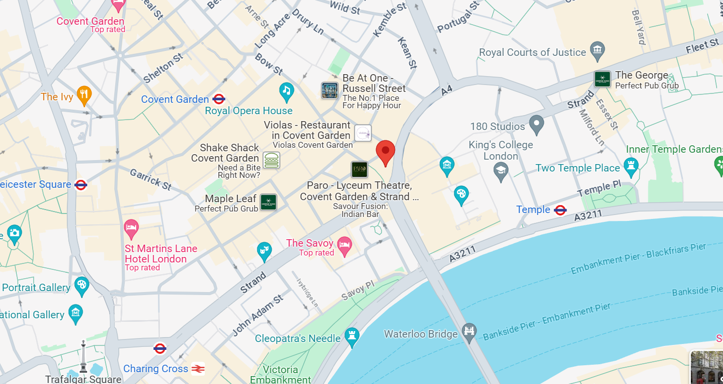
Lobby Bar / Downstairs at One Aldwych https://www.onealdwych.com/
ICGer notes: The main downstairs lounge at One Aldwych
1 Aldwych
London
WC2B 4BZ

Slide 10
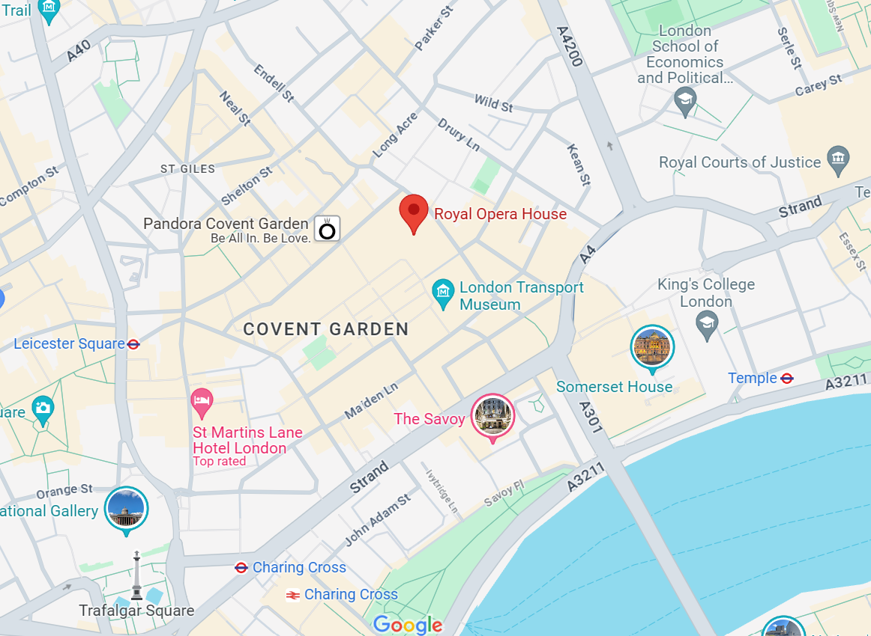
Café / Terrace Bar, Royal Opera House https://www.roh.org.uk/visit/eat-and-drink
ICGer notes: The cafe at the top of the royal Opera house in Covent Garden is great. It’s a real secret and very quiet during the day. I’d highly recommend it.
Piazza Terrace Bar / Café are open to all, no booking required, Open from 12pm
Royal Opera House
Bow Street
London
WC2E 9DD

Slide 11
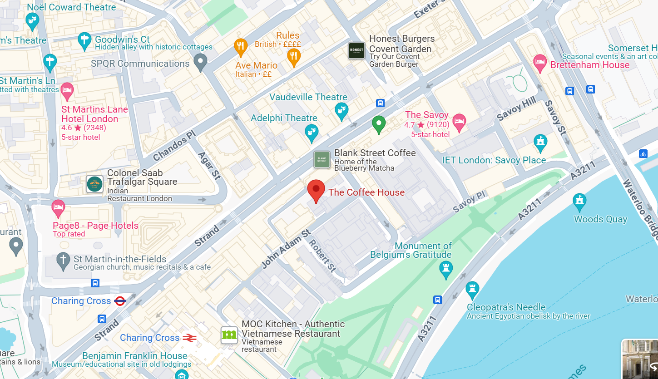
Coffee House in the RSA https://www.thersa.org/rsa-house/coffee-house
ICGer notes: I really like the Coffee House in the RSA. Some quiet spaces, and a nice (but small) café
RSA House
8 John Adam Street
London
WC2N 6EZ

Slide 12
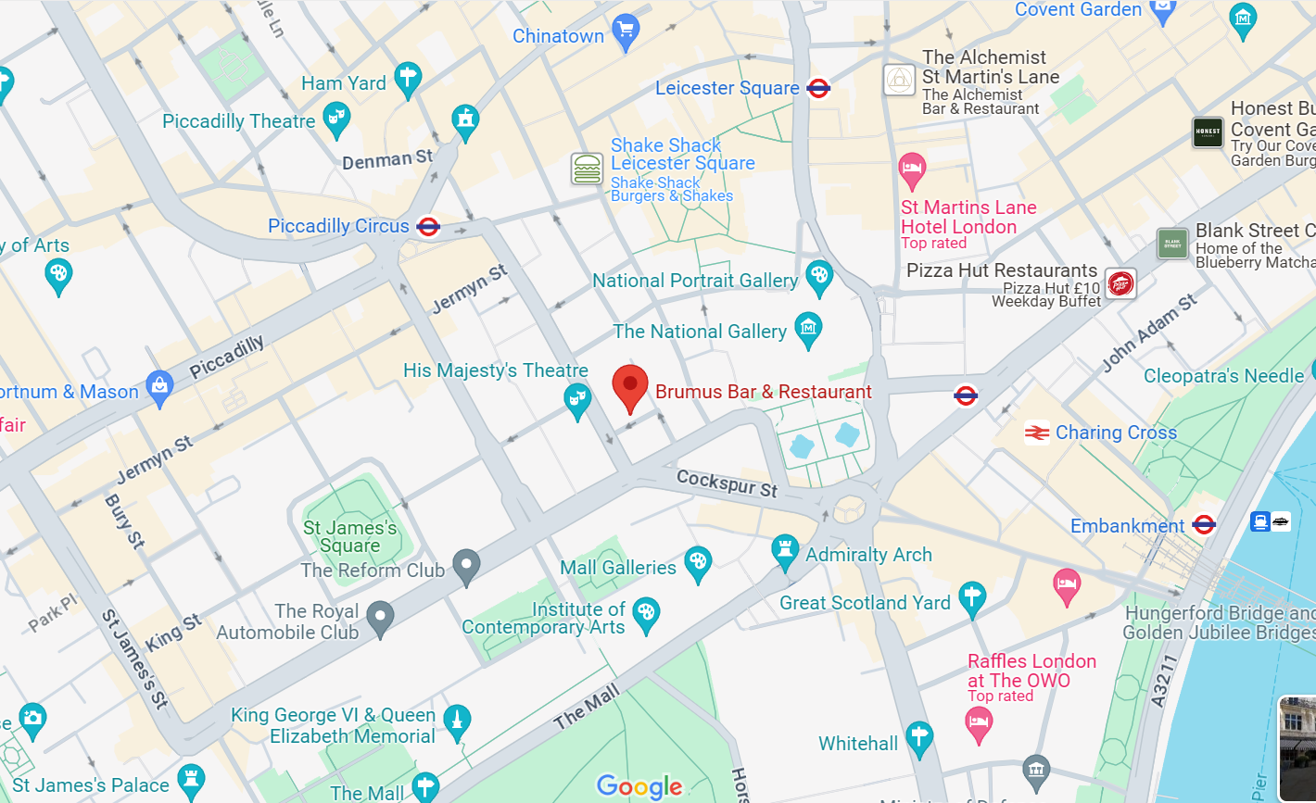
Brumus in Haymarket Hotel https://www.firmdalehotels.com/hotels/london/haymarket-hotel/brumus-bar-restaurant/
ICGer notes: The person I met at Brumus uses it all the time and was having meetings pretty much throughout the whole day. The staff were really great and there were obviously others there using it for the same purpose. Absolutely perfect. Big but very quiet.
Haymarket Hotel
1 Suffolk Place
London
SW1Y 4HX

Slide 13
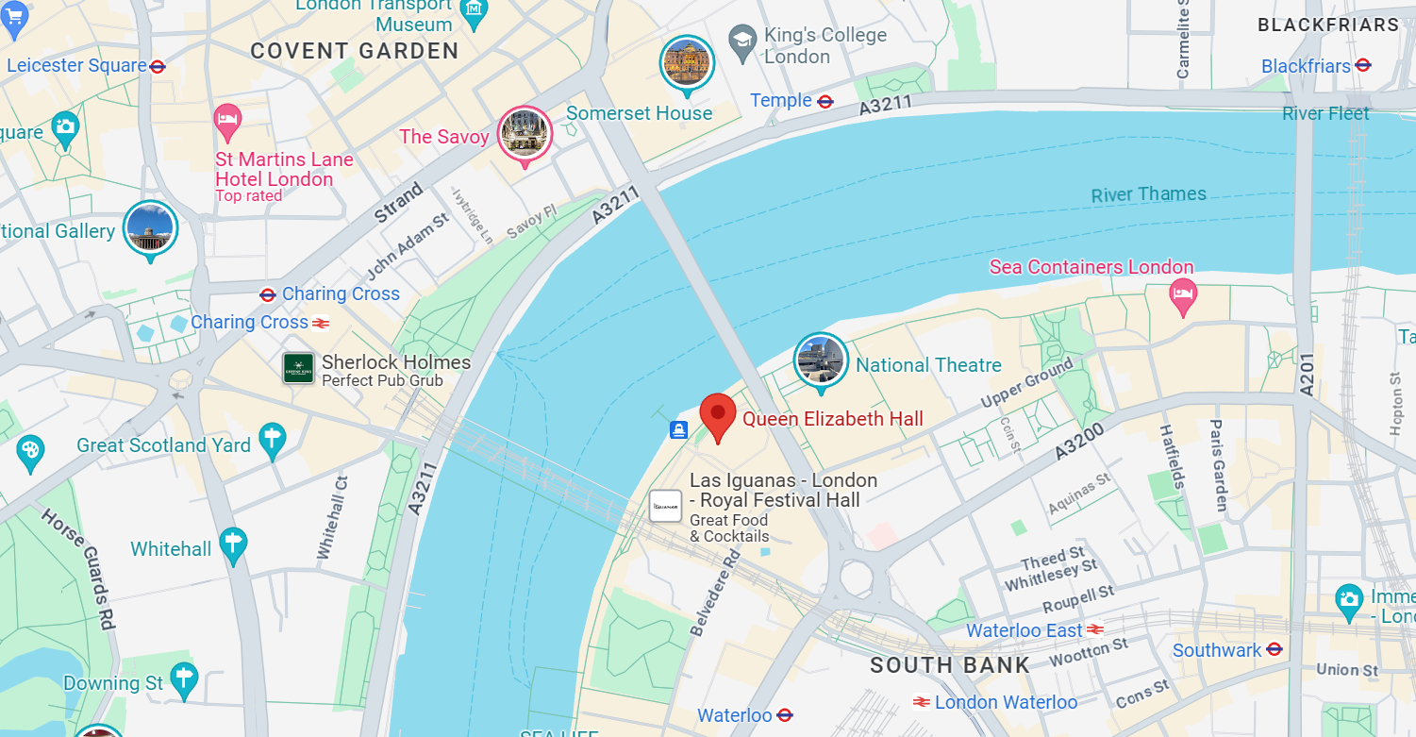
Concrete Café, Queen Elizabeth Hall Foyer, Southbank Centre https://www.southbankcentre.co.uk/visit/cafes-restaurants-bars/concrete-cafe
ICGer notes: A number of semi-circular leather seated booths good for <4 people, several stools on workbenches for solo work / 2 people. Plenty of power sockets. Lots of chairs by the coffee counter. Tons of people using the space as a working / meeting / socialising area. Free wifi. Café has usual range of coffee / pastries , staff very relaxed about people using the space – no pressure to spend money or move on. Large windows overlooking the Thames. Open from 10am. Gets quite busy, recommend arriving earlier to ensure a space.
Southbank Centre Belvedere Road
London
SE1 8XX

Slide 14
Other options are also available…
The chain of "Hubs by Premier Inn" also has an on-site café which tends to calm down after 10am as most tourists are off exploring. There are several in London. https://www.premierinn.com/gb/en/hub.html
All of the Holiday Inn hotels have Starbucks (real not “we proudly serve”) and free wifi. It’s a brand that’s lifting itself up so worth going to see it improving!
Most Prets have table space if you avoid 12.30-2.30pm, and they all have power sockets near most of the tables.
Try the branch at 95 Cannon Street, The Walbrook Building, London EC4N 5AE which has a large basement seating area.
LABS https://labs.com/ Requires a day pass
I recently used -3 cafe/restaurant at national portrait gallery but didn’t see electric points
Eat and drink - National Portrait Gallery (npg.org.uk)

