Slide 1
Norstat Creds
Ashley Campbell – November 2024
We deliver data to trust, for your most well-founded decisions.

Slide 2


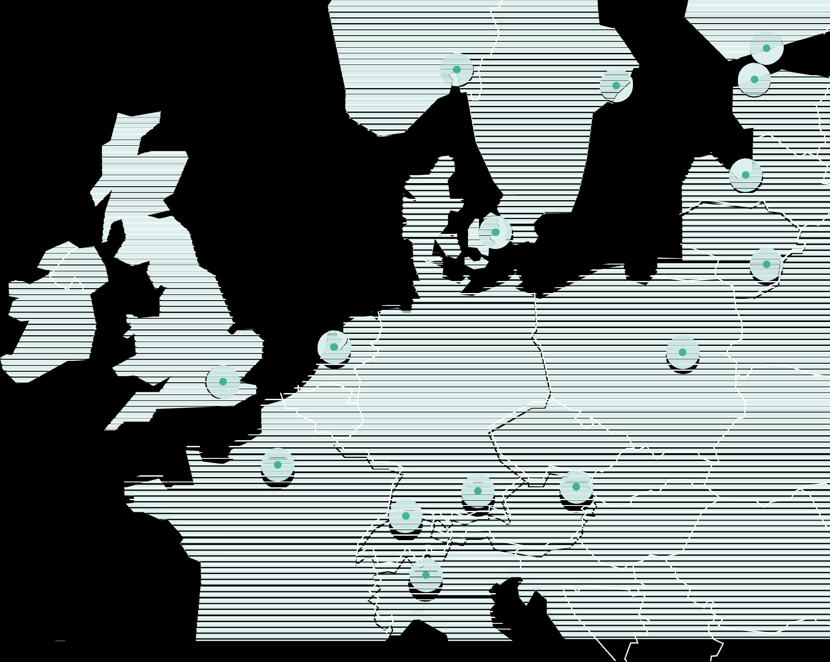
Who we are
Founded in 1997, we are one of the largest and leading data collectors for market research in Europe. We provide best-in-
class data about any desired topic or target group by using fair
and transparent data-gathering methods.
We use our own extensive international panel network and our trusted relationship with respondents. In our experience, insight seekers value quality and speed. Automatization of data collection ensures speed and efficiency, while robust quality assurance safeguards that our data is trustworthy.
One of the leading data
collectors in Europe
Part of our
network of
respondents
We would not have succeeded
without our very talented,
dedicated employees
300 + +
4 million+
High quality data for
decisions that matter
Interviews
Offices in 15 countries
around Europe
9 million+
Countries with panels
1800+
19
Customers
Established in Norway
10,000+
1997
Projects
completed
per year

Slide 3
Consumer Panels

Slide 4
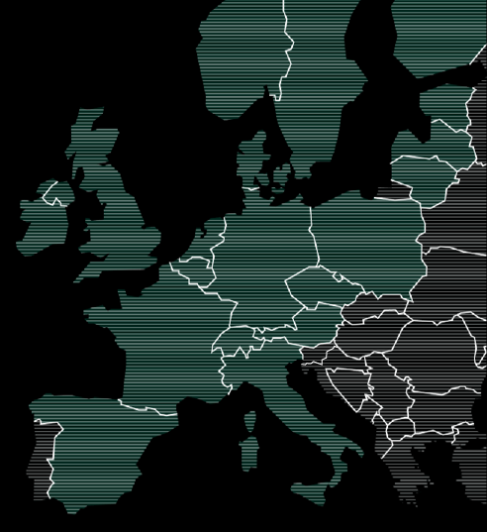



















Panel overview
Austria
France
Lithuania
Active panelists: 14,630 Response rate: 25%
Active panelists: 48,573 Response rate: 23%
Active panelists: 23,010 Response rate: 40%
Belgium
Germany
Netherlands
Sweden
Active panelists: 771 Response rate: 30%
Active panelists: 69,984 Response rate: 24%
Active panelists: 43,652 Response rate: 21%
Active panelists: 120,303 Response rate: 33%
Denmark
Ireland
Norway
Switzerland
Active panelists: 81,372 Response rate: 36%
Active panelists: 17,244 Response rate: 16%
Active panelists: 119,342 Response rate: 28%
Active panelists: 36,609 Response rate: 8%
Estonia
Italy
Poland
The Czech Republic
Active panelists: 25,339 Response rate: 46%
Active panelists: 34,442 Response rate: 29%
Active panelists: 56,102 Response rate: 18%
Active panelists: 586 Response rate: 45%
Finland
Latvia
Spain
United Kingdom
Active panelists: 65,077 Response rate: 43%
Active panelists: 18,180 Response rate: 41%
Active panelists: 1,119 Response rate: 67%
Active panelists: 76,258 Response rate: 19%
*The number of active panelists in the Norstatpanels that have responded to a survey within the last six months or signed up for the panel within the last 12 months.

Slide 5
Panel Variable Categories
Automotive
Number of Cars in Household
Car Brand
Car Purchase Condition (new/used)
Electric Vehicles
Demographic & Household
Age
Gender
Region
Social Grade
Ethnicity
Education
Home Status (own/rent)
Political
Children Age and Gender
Pets
Household Decisionmaker
Appliances
Energy Supplier
Broadband Provider
Utilities
Employment
Occupation
Job Role
Job Department
Job Responsibilities
Business Decisionmakers
Work Sector
Company Size (employees and turnover)
Finance
Personal Income
Household Income
Insurance Policies
Savings & Investments
Health & Lifestyle
Exercise
Conditions
Treatment and Medication
Nicotine Products
Media & Entertainment
Mobile Brand & Network
Social Media
VOD Subscriptions
Audio Subscriptions
News
Magazines
Gaming
Gambling
Retail
Grocery Stores
Consumer Goods Purchased
Fashion (clothes and footwear)
Sport
Sports Participation
Sports Followed
Travel
Business Travel
Leisure Travel
Transport Method
Public Transport
Accommodation

Slide 6




Recruitment approach and quality controls
By invitation only and double opt-in
Onboarding
Representative
Joining Norstat panel is by invitation only. Our registration sites are "hidden" from the general public and accessible only by invitation. We recruit via "double opt-in“ with a high share of self-controlled channels
Welcome survey to anyone joined Norstat helps with profiling each panelist, allowing us to target them precisely later and optimize survey/recruitment experiences.
Our recruitment focuses on the representativeness. For example, we focus more on the young male in England and Wales as we see they are under representative on our panel currently.
Speeders control
“Red Herring” trap
IP checks & duplicates
We control the speed with which our surveys are completed (“speeders”), our system blocks these accounts automatically.
We endorse the use of Captcha, trapdoor, red-herring and open-ended questions within our survey to be used as quality control measures. All panelists who do not respond seriously are automatically dismissed.
We carry out several controls. We also detect duplicates and cheaters based on their IP address and mailing address. They are discarded automatically by our control system.

Slide 7
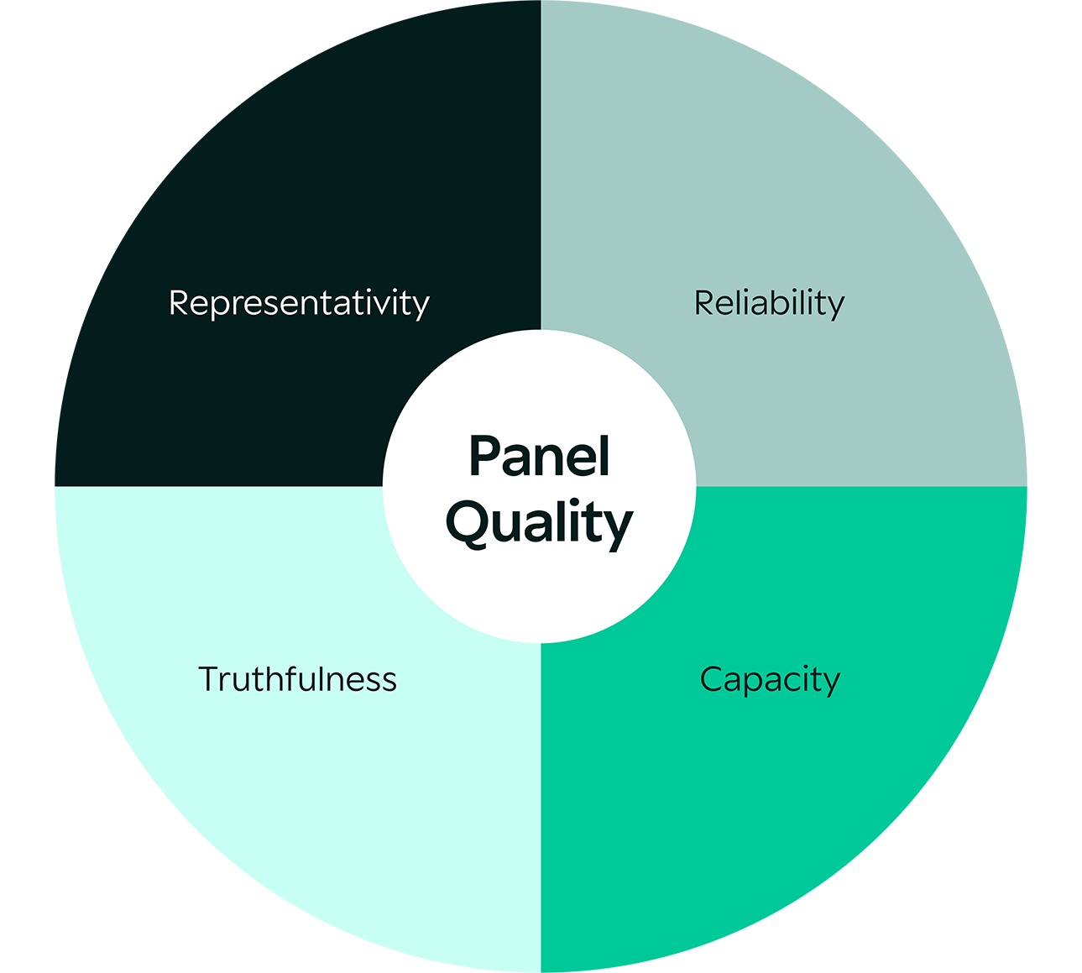
Panel quality - key questions to ask your panel provider
Does the panel consist of real individual consumers?
Does the panel composition correspond to the composition of the general population across several variables?
Does the panel composition correspond to the composition of the general population across several variables?
Does the panel have capacity to deliver unique data?
Read our response to ESOMAR 37 questions

Slide 8

Norstat Data Shield
Key Features:
Detection of Speeders: Norstat Data Shield accurately identifies respondents who complete surveys at an unnaturally fast pace, ensuring that only thoughtful and genuine responses are included in your dataset.
Analysis of Open-end Answers: The application scrutinizes open-ended responses to detect and remove nonsensical or irrelevant answers, enhancing the quality of the collected data.
Straight Line Response Detection: Norstat Data Shield spots straight-liners, respondents who provide the same answer to all questions, ensuring the exclusion of these low-quality responses.
Identification of Data Pattern Anomalies: The tool uses advanced algorithms to find and flag unusual response patterns that may indicate fraudulent activity or disengaged participants.
AI-Powered Fraud Detection: Leveraging the power of artificial intelligence, Norstat Data Shield continuously learns and improves its detection techniques, adapting to new fraud patterns and enhancing its accuracy over time.
Norstat Data Shield is a cutting-edge AI based application designed to ensure the integrity and reliability of your survey data. This robust tool delivers clean and trustworthy data for your analysis
With Norstat Data Shield, you can confidently rely on the authenticity of your survey results, knowing that every response has been meticulously vetted for quality and credibility.
Empower your data collection process with Norstat Data Shield and unlock the true potential of your survey insights.

Slide 9
Data Collection Services

Slide 10










Quantitative Services
Precise targeting
Scripting
Fieldwork - follow up
Data Processing
Bespoke targeting (designed for clients)
Various existing panel variables
Geo-targeting (e.g. postcode)
Recruitment from customer database
20+ DP programmers
Custom programming
Multilingual approach & translations
Responsive and elegant design
Gamification in surveys for more engaged respondents and better survey data
Daily management
Quality check
Dedicated project manager
Tracking dashboard
Raw data
Coding of open-ended questions
Simple tabulation & cross-tabulation
Live bespoke dashboard
Complex processing (MaxDiff, response level, etc.)
IHUT
CLT
Face 2 Face
Mystery shopping
Pre-validation
Logistics management
In-depth surveys on the Norstat mobile app before, during, and after the use of the product
Pre-validation
Logistics management
Tablet surveys before, during, and after the use of the product
Venue available in a central location across 15 Norstat offices
Recruiting surveyors
Tablet surveys
Street interception
Shopper training
Online reporting

Slide 11




Full service – Online data collection
Project management
Survey scripting
Data collection
Data delivery
Our project managers address your needs and tailor a fitting process. Then they take ownership and drive the entire project allowing you to put your focus elsewhere. Experienced in a wide range of survey types, they know what your specific situation requires to get the high quality data you need.
Our scripting experts use their skills to ensure relevant results are acquired from the study participants. All packaged in user-friendly and intuitive online surveys, equally engaging on any device – from desktop to mobile.
Few know their sources like we do. Our respondent network is one of the leading in Europe and it is built on longstanding relationships. All to deliver the most relevant data regardless of collection method, qualitative or quantitative. Always delivered with efficiency and uncompromising quality.
Get the comprehensive data overview you need in any format you require. We do everything from data management, such as cleansing, formatting, and reporting to visualisation, tabulation and charts. All to give you in-depth knowledge and provide the perfect foundation for insights.

Slide 12
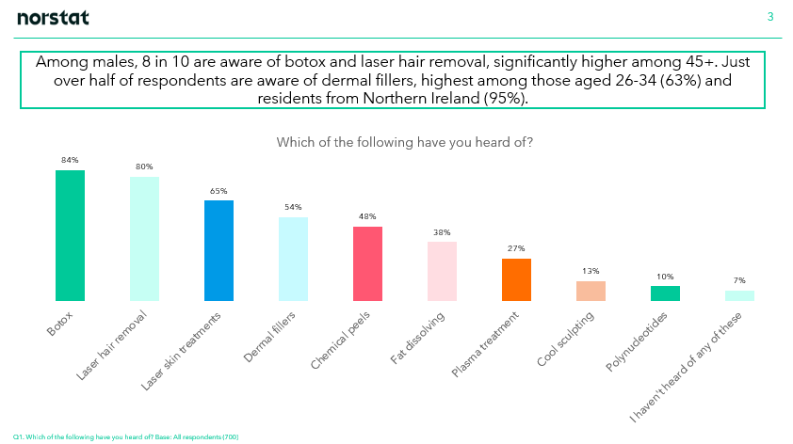
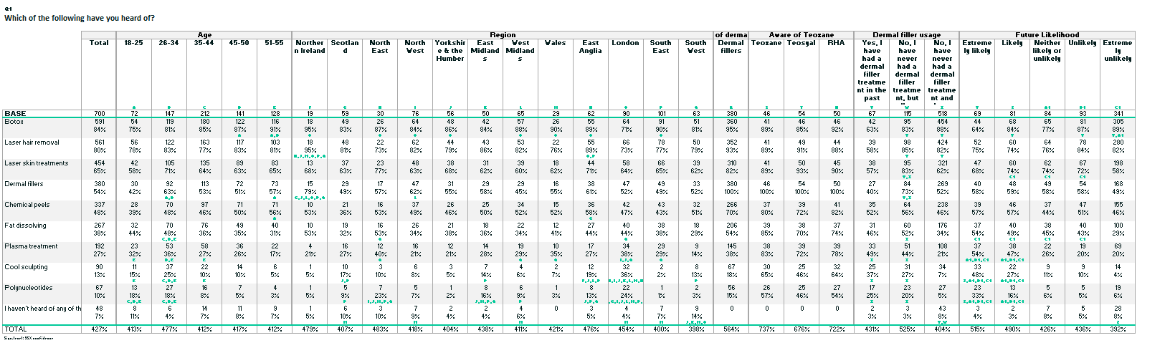
Norstat Slides & Tables
Once data has been collected, we are able to run Norstat Slides and Norstat Tables, these are autogenerated, saving costs and time, allowing us to deliver a fast cost-effective option to insight and analysis.
Bringing your data to life, being able to visualise the data trends.
PowerPoint slides can be in your template, logo, palette - presenting your data with descriptive headers.
We can add an AI summary slide, which brings all the main conclusions together, using our Norstat Notes software.

Slide 13
Norstat Notes – A bridge between your data and AI
FEED DATA
DEFINE DATA
ANALYSE DATA
INCLUDE IN SLIDES
Norstat data is feed into AI system
Client defines which questions to be analysed and how deep the analyses should be
AI Analyses is done per question as well as an overall conclusion with key takeaways
Analyses is included in PPT slides
*Norstat is using ChatGPT 4 for analyses of data. No data is stored by ChatGPT.
Norstat is only providing the API to ChatGPT and is not responsible for the analyses done.

Slide 14
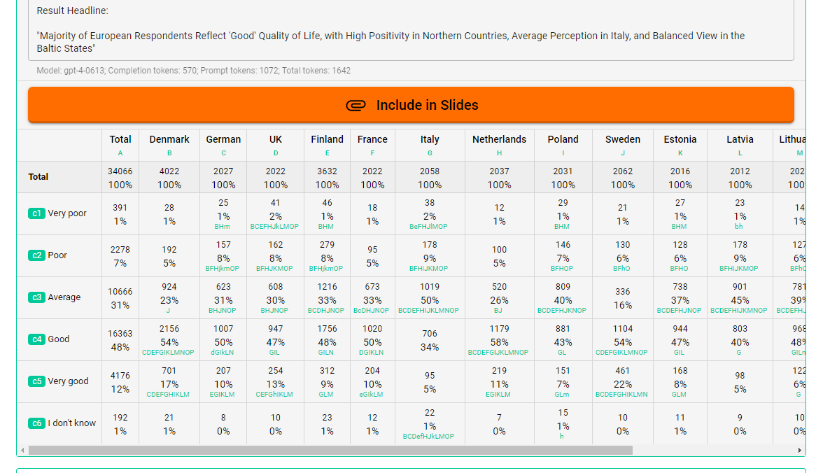
Norstat Notes – Example output (1)

Slide 15
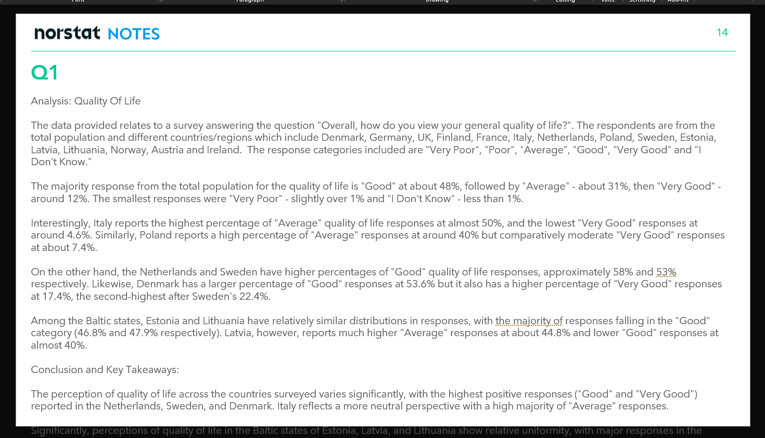
Norstat Notes – Example output (2)

Slide 16
Immediate overview with great service
Get the comprehensive data overview you need in any format you require.
With Dashboards, you get an intuitive interface, optimally designed to visualise your KPI’s and make informed decisions with ease.
All with help close at hand.
All in one
Sharable & accessible
All data in one place for easy analysis and report creation.
Tailor made brand and consumer insight tracking.
Serviced by experts
Superior tracking
Highly skilled, attentive team makes interaction smooth and pleasant.
All dashboards are sharable and exportable in all major formats, including PPT.
Norstat Dashboard Standard/Premium
Norstat Dashboard Lite
Two different Dashboards – try it out now:

Slide 17
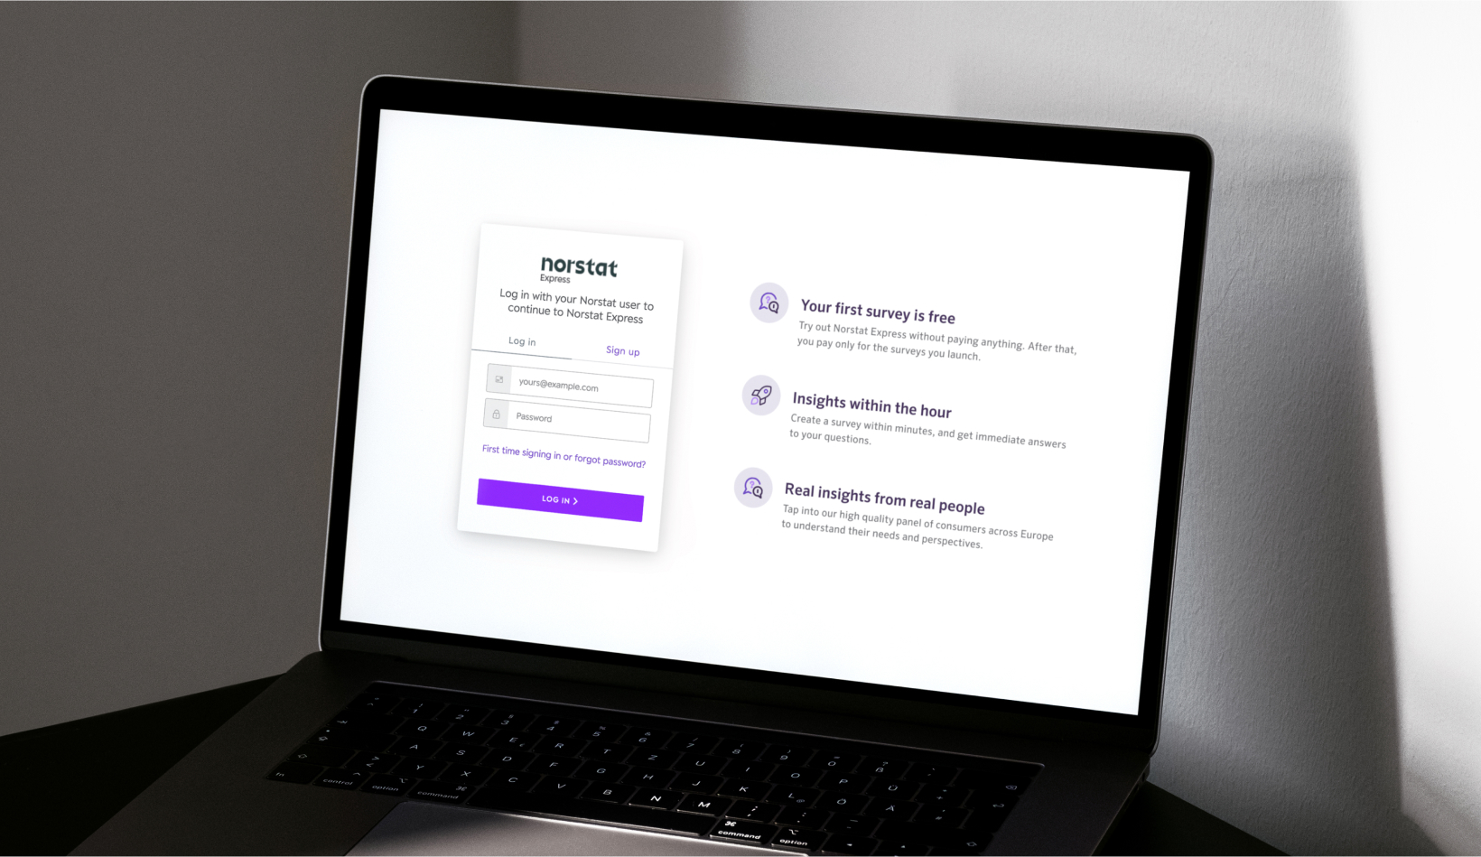
A self-service solution for immediate access to our consumer panels
1.
Web-based solution. Access and login via link: Norstat Express login
Select target group (you can send to everyone, or segment by gender/age/country)
Choose the number of respondents
(choose between 10-500 respondents)
Set up questions (max. 5 questions per broadcast)
Send out to the Norstat panel
You can see the results continuously and live
in the dashboard
You can do simple filtering on the results and
download in Excel/CSV
2.
3.
4.
5.
6.
7.

Slide 18

Qualitative Services
Recruitment
IDIs or Focus Groups
Bespoke targeting (designed for clients)
Various existing panel variables
Dedicated contact
Validation call
Recruitment from customer file
Confirmation and reminder via call and SMS text
Onsite in one of our Norstat viewing facilities
Remote via online platform designed specifically for market research purposes
Moderation & Transcription
Online communities
Daily panel support to address queries
Recruitment-only or full service
Moderators with relevant experiences via our network
Sim-translations or transcriptions available in the language of your choice

Slide 19



Ashley Campbell
Sales Director
Norstat UK & Ireland
Ashley.Campbell@Norstat.co.uk

