Slide 1


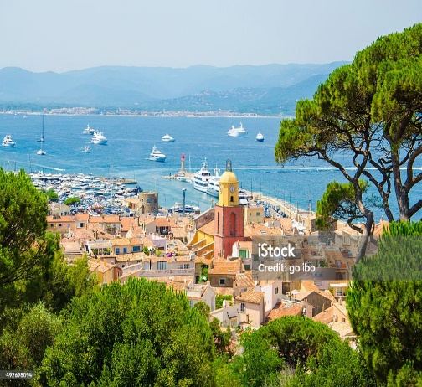
Why is France Different?
Some considerations to conduct market research in France
7 January 2025
Notes:
1

Slide 2
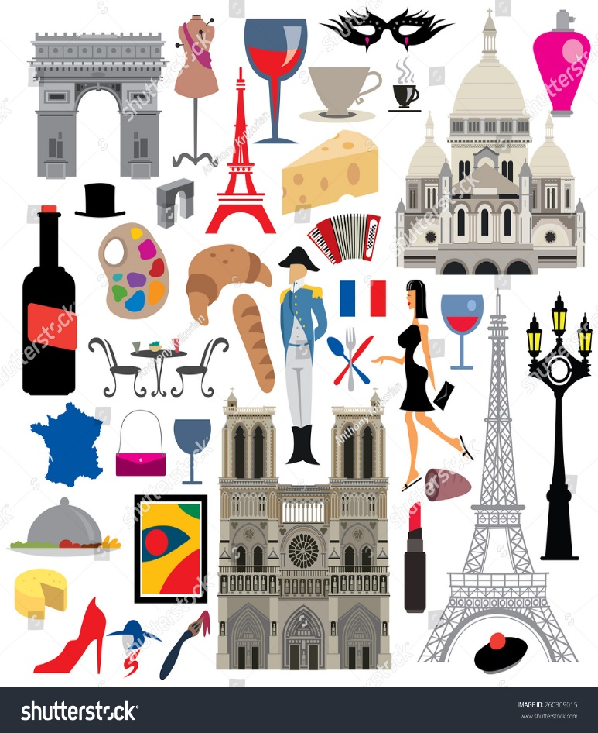
Considerations for conducting market research in France
Introduction
Background information: Key cultural and socio-economic factors
The French consumer market
The French consumer
Tips to relate to French consumers
Practicalities for conducting qualitative market research in France
Questions ?
Notes:
2

Slide 3

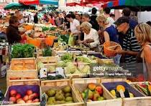

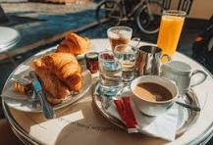
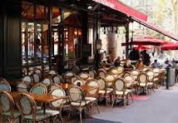
Why is France Different?
France’s uniqueness is the result of a rich, multifaceted history shaped by key factors that have influenced its lifestyle, culture, politics, and identity.
Communicating a positive understanding of French culture is key to connect with the French consumer, make them open up and get real actionable insights.
Notes:
3

Slide 4

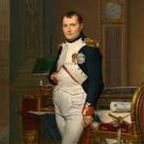
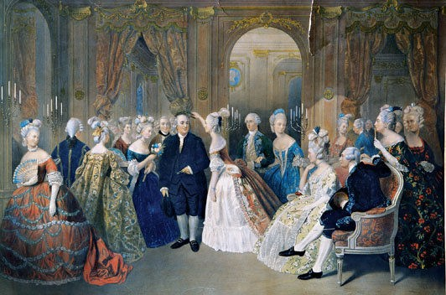
Key cultural and socio-economic factors
  Regional / Ethnic Diversity / Religion
  Historical Influence
  Cultural Heritage
  Social Structure
  Cultural Norms and Etiquette
  Geography
Notes:
4

Slide 5

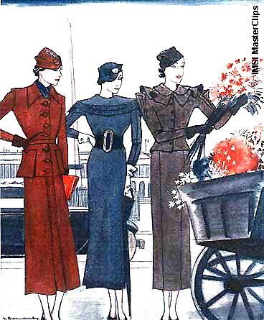

Key cultural and socio-economic factors
Quality and Tradition
  Cuisine and Gastronomy
  Fashion and Aesthetics
  Elegance and Style – Fashion plays plays a crucial role in French consumer behaviour, and attitudes. From haute couture to casual wear, consumers are highly attuned to aesthetics and are willing to invest in style. This extends to home décor, cars, and even food presentation.
  Timeless over Trendy: While trend-conscious, French consumers tend to favor timeless style over fleeting fashion. This is evident in their preference for classic designs and investments in quality items that last.
Notes:
5

Slide 6
Key cultural and socio-economic factors
Quality and Tradition
  Fashion and Aesthetics
  Trends towards small high end local brands made in France - or other countries with expertise
  Appreciation / choice of food and clothing is a reflection of one’s personal culture.
  In 2021-22, the Paris stock market surpassed the London Stock Exchange due to the performance of the luxury goods sector. E.g. LVMH (largest company in Europe by market capitalisation)
Notes:
6

Slide 7

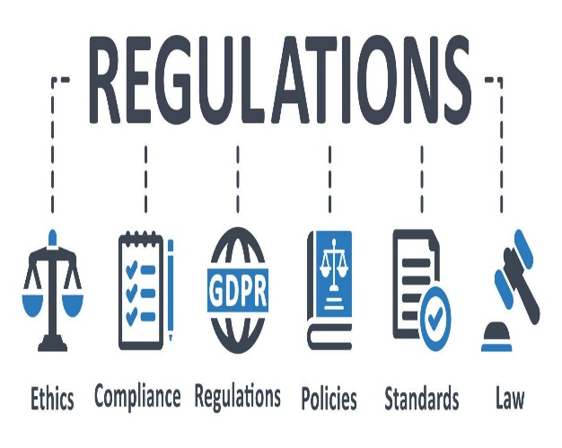
Other factors
Sustainability
Policies - government, rules and regulations – esp. re product safety, and quality standards.
Notes:
7

Slide 8
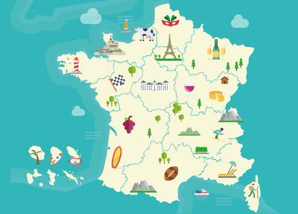
Key cultural and socio-economic factors
  Income Levels and Economic Stability – largest public sector than in UK
  Education and Meritocracy – France has a high level of education, which plays a key role in social mobility. Education is secular and free.
  Income is one aspect but does not define demographics – education does.
  France has a central administration based in Paris, but Paris does not represent the whole of France. French regions have their unique specificities and local economies are thriving.
Notes:
8

Slide 9
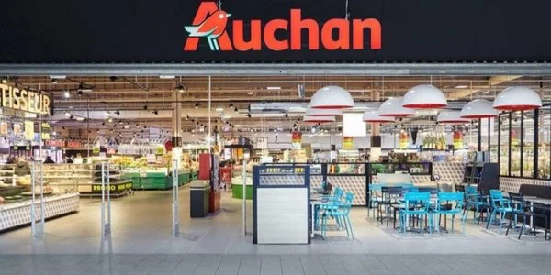
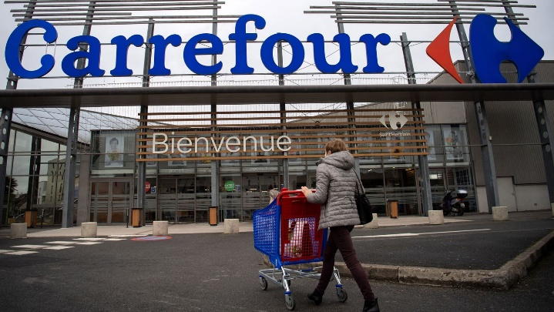
Considerations for Qualitative Research in France – The French Consumer Market
France is the second largest consumer market after Germany and before UK.
Favourite sectors are: food, drinks, cosmetics, leisure, sport, fashion, health and wellbeing.
The Retail sector is significant with main retail chains being Carrefour, Leclerc, Intermarché, Auchan. With their attractive fresh counters, supermarket chains compete with the best local shops, selling locally produced high quality products.
Notes:
9

Slide 10
The French Consumer Market
Although one of the largest economies in Europe, when it comes to GDP per capita, France ranks in the middle of the pack compared with other European countries, at a similar level than UK.
Internet use is one of the highest in Europe. However, French people were initially slower at adopting e-commerce, but online shopping has grown significantly, particularly for fashion, electronics, beauty products, and luxury goods e.g. (L'Oréal sells 25% of its high-end products online).
Notes:
10

Slide 11
The French Consumer
  Time conscious and convenience-driven behaviour – fast-paced lives, urban consumers who tend to be busy esp. in Paris likely to prioritise convenience
  However, services like food delivery are not very much used yet and there is a deep cultural appreciation for taking time to savour meals and experiences.
  Balanced Lifestyle: French consumers seek a balance between their busy work and personal lives, and often prioritise experiences, such as dining out, travel, or enjoying leisure time with loved ones.
Notes:
11

Slide 12
The French Consumer
  Gender equality is high on the French agenda. The proportion of full-time working women however, is slightly lower than it is in the UK (around 50% against 55-60%).
  France enjoys a good health system, which has suffered in recent years
  Like most European countries, France suffers from a declining birth rate - which decreases with the improvement of standard of living.
Notes:
12

Slide 13
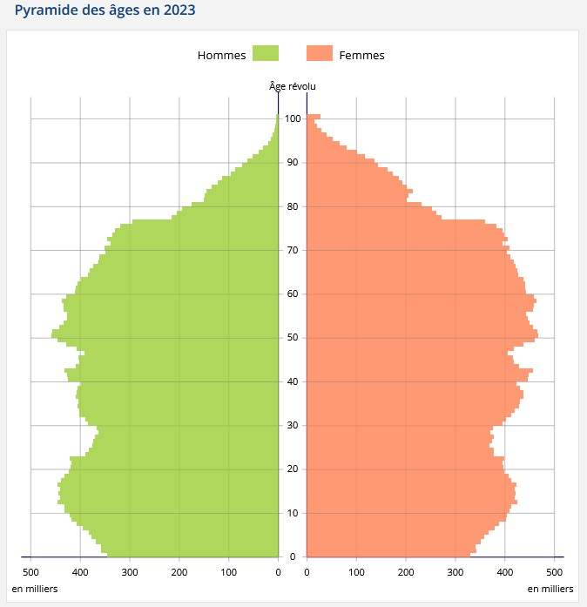
The Age Pyramid Becomes Obsolete

Slide 14
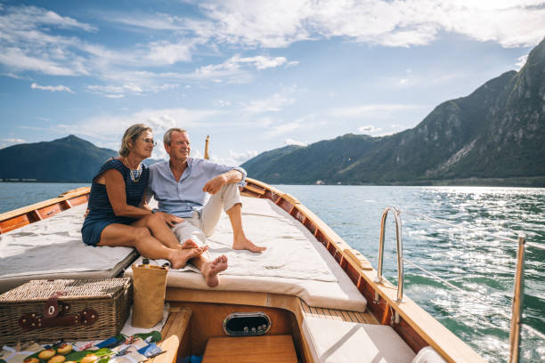
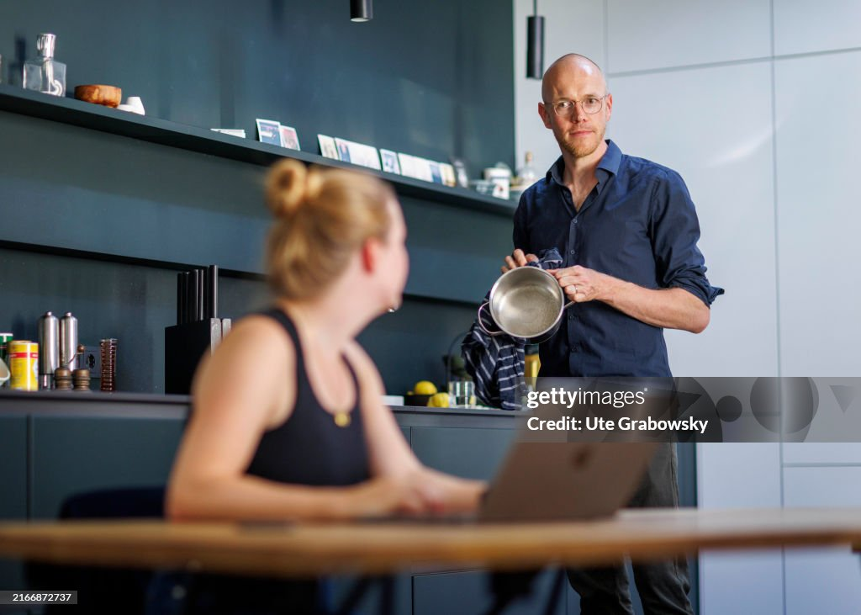
The French Consumer Market
Retirement age in France is 64 ? (the rise between 62 and 64 is not yet accepted by French people) - one of the lowest in Europe
French pensioners are better off then their UK counterparts, and enjoy leisure activities, holiday, cooking, eating out, shopping.
Notes:
14

Slide 15
Summary
France’s diverse regions and historical events, like the Revolution and Napoleon, shape its modern identity.
France has a fluid social system, with social safety nets, and stable incomes. Traditional and modernity co-exist harmoniously, regional differences impact lifestyles.
French consumers value quality, prefer sustainable products, and favor timeless over trendy styles.
Notes:
15

Slide 16
Summary
France is a major consumer market, with growing online shopping, though traditional retail and quality food remain key.
A social safety net, stable income levels, a good health system and local economies which provide value for money, quality and organically produced products make French lifestyle comfortable for less income than in UK.
Notes:
16

Slide 17
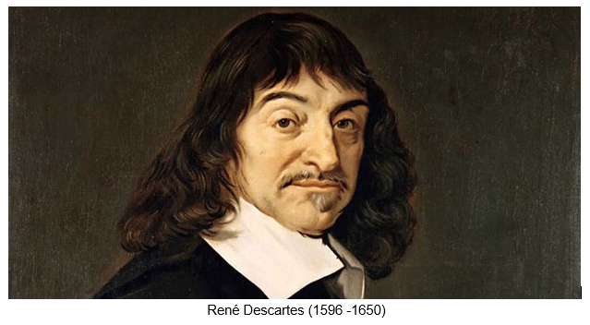
The French Consumer
Language and Communication: French people are opinionated - the French like philosophy and principles – Descartes ‘cogito,ergo sum,‘I think, therefore I am’ – (a bit far-fetched), but it’s the idea that if we are able to think, doubt, debate, question, it means that we exist in some capacity.
Verbal communication style tends to be direct – people don’t hold back
Language, grammar, semantic, are important. They define people.
French people like speaking in French – even business people prefer to be interviewed in French, even if they can speak English.
Notes:
17

Slide 18
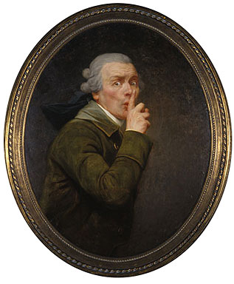
The French Consumer
Although talkative, French people are reserved when it comes to discussing certain topics traditionally considered taboo in French society
  Money matters are part of each family’s unique private culture. They are not generally discussed with people outside the close family. French people are reluctant to disclose and discuss income, investment, property prices, inheritance, tax etc.
  This may be due to the values of the French Republic with its emphasis on equality.
  Boasting and showing off are considered vulgar.
  One’s health is also considered a private matter
Notes:
18

Slide 19
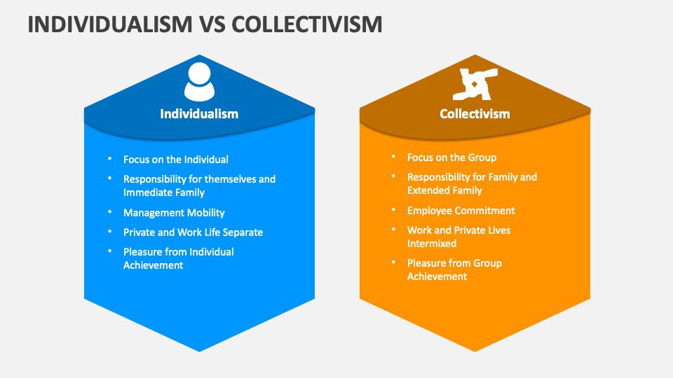
Individualism with a Focus on Collectivism
Personal Expression: French consumers tend to value personal expression through their purchases. Whether it's fashion, art, or lifestyle choices, there is a strong desire to stand out and be individualistic.
Balance with Community Values: While personal choice is important, French consumers are also driven by a sense of collective culture, especially in terms of social norms.
There is a preference for products that align with French societal values, such as enjoying time with family and friends over a meal or taking part in public cultural experiences.
Notes:
19

Slide 20
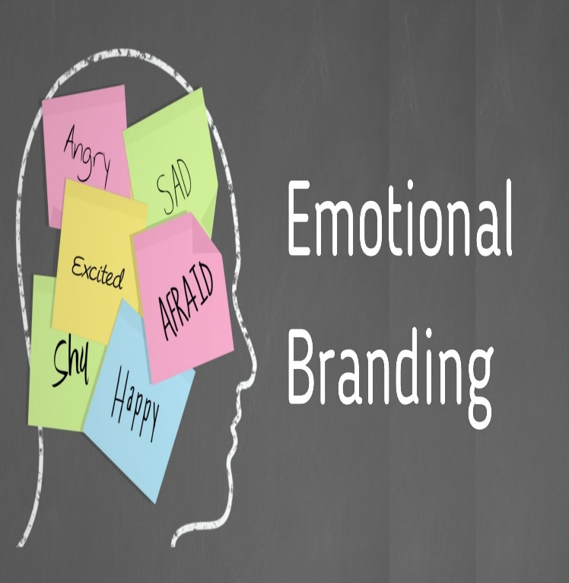
Brand Loyalty and Emotional Connection
In France, consumers often feel a strong emotional connection to certain brands, particularly those that evoke nostalgia or align with their identity.
Brands that manage to create an emotional story or narrative tend to foster stronger loyalty.
Brand Heritage / History / Reputation / Craftmanship leads to Brand Loyalty
Word-of-Mouth and Trust: Recommendations from friends, family, or trusted sources (like influencers) play a significant role in shaping purchasing behaviour. French consumers are more likely to trust peer reviews and word-of-mouth rather than advertising alone.
Notes:
20

Slide 21


The French Consumer – Summary
The psychology of French consumers is shaped by a strong cultural attachment to quality, luxury and tradition, alongside modern concerns for sustainability, and individuality.
Consumers in France seek products and services that align with their personal identity, values, and lifestyle, maintaining a discerning eye for value, authenticity, and craftsmanship.
It’s about trying to express one’s personality through choice of brands and products, whilst conforming to strict social norms, codes and values.
Notes:
21

Slide 22

Tips to relate to French Consumers
Specific nuances and considerations that can significantly affect the research process and the outcomes.
  Nuances and details are important – explore opinions, preferences, motivations in depth to understand what is coming from a personal opinion and what’s due to the cultural context.
  Formal, polite communication helps build trust and encourages open, honest responses
  Show understanding and respect for – and ideally that you like – French culture.
    E
Notes:
22

Slide 23


The Practicalities of Conducting Qualitative Research
Methodological Considerations
  Preference for face-to-face methodology for sensitive topics
  Online is the preferred / easiest methodology but there is a lot of value in personal interactions
  French consumers excel in group discussions – being talkative, engaged, passionate, opinionated, liking to debate. Skilled moderation required. And time - 2 hours to get content and engage in group dynamic is a good idea.
  Use of Projective Techniques – French consumers respond well to metaphors, word associations, stories, creativity - collages, videos, pen portraits, typologies.
  Be prepared to get and to analyse a high level of content.
Notes:
23

Slide 24
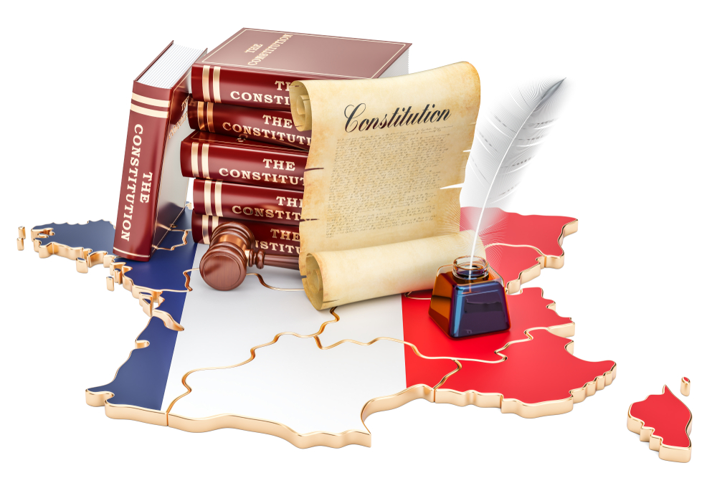
The Practicalities of Conducting Qualitative Research
Analysis and Interpretation
  Attention to Language and Semantics - Language plays a crucial role in qualitative research. The way consumers express an idea is as telling than the idea itself.
  Always consider the broader cultural and social context. What is the product / brand rooted in from a cultural / French tradition perspective?
  A holistic approach will provide more meaningful insights.
Notes:
24

Slide 25

The Practicalities of Conducting Qualitative Research
Recruitment
  Requires significant planning. Trust and respect recruiters as they are a source of information about markets, habits, regional diversity. They know how to approach target groups and select reliable and valuable participants for each project, but they need time.
Incentives
  Are more generous than in UK. Consumers / Customers expect it and good quality research among genuine, reliable, committed, and busy respondents means incentivising them properly.
Do not get Lost in Translation
  Trust human interpreters and translators as they will produce accurate and meaningful screeners, topic guides and transcripts, producing the best outcomes for your clients.
Notes:
25

Slide 26

Considerations for Qualitative Research in France
Regulatory Compliance
  French consumers are cautious about their personal data and are particularly sensitive to privacy issues. Privacy laws are strict.
  Make sure confidentiality is respected – this will yield to more candid and reliable information. This reflects a broader cultural norm of valuing individual rights and freedom. GDPR, ‘Droit a l’Image’ procedures for example take time to be put in place as a lot of bureaucracy is involved.
Notes:
26

Slide 27

Finally, Last but not Least!
French people have more holidays / bank holidays than their European and American counterparts
In summer French people are usually away from mid-July to mid-August.
List of holidays and ‘ponts’ in 2025: (5 days = 32 days)
  New Year's Day: 1 January
  Easter: 19-20-21 April
  Labour Day: 1-2-3-4 May
  WWII Victory Day: 8-9-10-11 May
  Ascension Day: 29-30-31 May 1st June
  Pentecost: 7-8-9 June
  Bastille Day: 12-13-14 July
  Assumption of Mary: 15-16-17 August
  All Saint's Day: 1 Nov
  Armistice WWI Day: 8-9-10-11 November
  Christmas Day: 25-26-27-28 December
Notes:
27

Slide 28
Any questions?
Notes:
28

Slide 29
THANK YOU!!
Notes:
29

Slide 30
Katherine Passerieu
Katherine is the founder of Passerieu Consulting
Katherine is bilingual and bicultural – A French national based in the UK, having studied and worked in France and in the UK, and providing market research services /insights to companies mainly based in Europe and in the US on the French market
Passerieu Consulting is a qualitative consultancy specialising in understanding the customer and carrying projects in the areas of brand / product and communication strategy.

Slide 31
Katherine Passerieu
Before setting up Passerieu Consulting in 2011, Katherine worked as a Director for a range of companies, leaders in their field, e.g.:
  Director at forward thinking, a boutique strategy consultancy
  GfK NOP - Director of Brand Strategy
  Censydiam UK - MD
  Cram International - Associate Director for the French market
  TNS (now WPP) Director of Qualitative and International Research
  Landor & Associates – European Research Director
  Ted Bates France – Director of Research & Planning
Katherine has used an array of methodologies online and offline for projects in all industry sectors
Background is Psychology
  Member of the MRS, ESOMAR, ICG, BACP, IoD

