Slide 1

Data Protection 2025
New Rules
New Responsibilities
For Insights Consultants Group
Notes:
Hello everyone. I’m Jude. I joined the ICG fairly recently so haven’t got to know many of you yet. I have 20 years experience working in the market research industry with the largest part of that at Firefish. I went independent to focus on compliance consultancy in January 2024 and set up Leggwork Services Ltd.
I help clients with data protection but also with procurement processes, client and supplier contract management.

Slide 2
What’s on today?
Focus on changes brought in by the Data Use & Access Act 2025 (“DUAA”)
Key changes that are of relevance to a broad audience
AI Governance
Overlaps with GDPR/DUAA
Compliance Checklist
To help you prepare and be compliant in 2026
Notes:
Not an exhaustive look at all changes, I’m focusing on the ones that are likely to be applicable to most of you
I’ll touch on AI Governance because there are some overlaps with privacy regulation
Finally, I’ll offer a checklist to help you prepare for the changes that will come into force in 2026

Slide 3
UK Data Protection Landscape
PRIMARY FRAMEWORK
UK GDPR (core principles, rights, duties)
Data Protection Act 2018 (UK tailoring, powers)
Amends elements of UK GDPR (e.g., DSARs, ADM)
Amends/supports DPA 2018 provisions
Adds new obligations (e.g. complaints)
DATA USE & ACCESS ACT 2025
PECR (electronic privacy)
Sits alongside for Cookies/Marketing
Watch out for the
first UK AI legislation

Slide 4
Summary of DUAA
The DUAA passed into UK law on 19th June 2025
The DUAA doesn’t replace existing UK laws but makes changes to the UK GDPR, DPA 2018 and PECR
AIMS
  clarify obligations, reduce administrative burdens and encourage innovation
  strike a better balance between protecting people’s data and offering more flexibility to organisations, especially (SMEs)
  use data in more efficient ways
  still be compatible with high privacy standards to protect international data-flow
WHEN ARE CHANGES IN FORCE?
Changes are being phased in now until June 2026
Sector specific guidance/secondary legislation still being drafted
Expect ICO guidance to be published Jan 2026
Sign up to ICO newsletter
https://ico.msgfocus.com/k/Ico/sign_up_form_january_2022
.
Notes:
Changes are being phased in up to June 2026. What I’m covering today are not yet in effect but soon will be
Yet to have full certainty on all the changes and exact timelines of when they will be in force
Sign up to ICO newsletters to stay in touch or other professional bodies such as the Market Research Society of the changes
Opportunity to review and refresh existing data protection policies and processes
The DUAA changes for most mean just adapting what you already have in place

Slide 5
Bedrock of GDPR is still
in place
1. PRINCIPLES
2. LEGAL BASES
3. DATA SUBJECT RIGHTS
1. Lawfulness, Fairness & Transparency
2. Purpose Limitation
3. Data Minimisation
4. Accuracy
5. Storage Limitation
6. Integrity & Confidentiality (Security)
And the principle of Accountability
1. Consent
2. Contract
3. Legal Obligation
4. Vital Interests
5. Public Task
6. Legitimate Interests
the right to be informed
the right to access personal data
the right to have rectification
the right to erasure (to be forgotten)
the right to restrict processing
the right to data portability
the right to object to processing rights in relation to automated decision making and profiling
the right to withdraw consent at any time (where relevant)
the right to complain to the Information Commissioner
*Not all are absolute/some circumstance dependent
Notes:
Useful to recap the founding pillars of data protection compliance to give context to the DUAA changes
Principles
1. Use data legally, treat people fairly, and be open about how their data is used.
2. Collect data for clear, specific purposes — don’t use it for anything incompatible.
3. Only collect the data you actually need.
4.Keep data correct and up to date.
5.Keep data only for as long as necessary, then delete or anonymise it.
6. Protect data with appropriate technical and organisational security measures.
Plus accountability - be able to demonstrate compliance e.g. privacy policies, ROPAs, DPIAs, DSAR procedure etc
Legal Bases
Consent – Clear, informed, freely given agreement; easy to withdraw.
Contract – Necessary to deliver a service or fulfil a contract with the individual.
Legal Obligation – Required to comply with UK law (e.g., tax, employment).
Vital Interests – Needed to protect someone’s life or prevent serious harm.
Public Task – Needed to perform official/public interest functions.
Legitimate Interests – Supports your organisation’s legitimate aims unless overridden by a person’s rights, freedoms and interests. Record a legitimate interest assessment

Slide 6
What’s changing?
Legitimate Interest Changes
Recognised Legitimate Interest, Direct Marketing, Automated Decision Making
Data Subject Rights Changes
Data Subject Access Requests/Complaints
International Data Transfers
EC Adequacy Decision
UK Regulator
New ‘Information Commission’
PECR & Cookies
Low Risk Cookies/Higher PECR Fines
Notes:
These are the changes I’m focusing on today

Slide 7
Recognised Legitimate Interest (RLI)
New 7th legal basis in addition to standard legitimate interest
Can be done without conducting legitimate interest assessment to balance rights, freedoms, interests of the person/people involved
As long as the processing is necessary
People must still have the right to object
5 pre-approved purposes for RLI
The Public Task Disclosure Request Condition
The National Security, Public Security and Defence Condition
The Crime Condition
The Emergencies Condition
The Safeguarding Condition
Notes:
Controllers can process personal data for one of the 5 pre-approved purposes
1. - share personal data with an organisation for public task/official functions
2. – process personal data for security & defence purposes
3. – process personal data for crime prevention and detection purposes
4. – process personal data to respond or deal with an emergency situation
5. – share/process personal data to protect the physical/mental/emotional well-being of children and vulnerable adults

Slide 8
The Safeguarding Condition
To use this condition, Controllers must:
Ensure the use of personal information counts as safeguarding
Be satisfied that the person to be safeguarded is either a child or an ‘at risk’ adult
Demonstrate that the processing of personal information is necessary to safeguard that person
Potential applicability in market research context?
A participant discloses information suggesting they or someone else is at risk of harm
A participant reveals ongoing abuse – domestic, child, elder
A child participant indicates they are being harmed – child discloses neglect or exploitation
Participant threatens harm to others
Participant discloses involvement in criminal exploitation – county lines/trafficking
Research uncovers an imminent risk in the workplace - B2B research context
Notes:
In the MRS Research Policy & Standards Webinar last month, Debrah Harding pointed to the Safeguarding Condition of having most relevance to research
I’ve suggested a few situations where this condition may apply
Overarching requirements are:
The RLI is justified and documented
The duty to protect life or safety outweighs the duty to maintain confidentiality.
You must act proportionately and only share what is necessary to relevant bodies

Slide 9
Direct Marketing & Automated Decision Making
Direct Marketing is now a formally recognised example of Legitimate Interest
now confirmed by law
most businesses were already taking this approach
Legitimate Interest can now be relied upon for Automated Decision Making
Before the legal bases were much narrower – consent, contract, law
Safeguards must be in place if the decision has legal or significant effects
Individuals must be informed and given a right to challenge decisions
‘Automated’ now defined as “no meaningful human involvement’ extending use of AI tools to automate decisions
The relaxation does NOT apply to special category data (e.g. health data, racial/ethnic data )

Slide 10
What safeguards are needed for ADM?
Information
The data subject must be informed that a significant decision has been taken about them by automated mean including likely consequences
Right to Challenge
The data subject must be able to raise objections
Right to human intervention
The Controller must allow the individual to request human intervention in the decision-making process i.e. a human to review and reconsider the decision
Right to contest the decision/appeal
The data subject must be able to contest the decision
Notes:
Information
The data subject must be informed that a significant decision has been taken about them by automated means.
This includes information about the fact of ADM, and likely its consequences or significance.
Right to make challenge
The data subject must be able to raise objections –
Right to human intervention
The controller must allow the individual to request human intervention in the decision-making process (i.e. a human to review and reconsider the decision).
Right to contest the decision / appeal
The data subject must be able to contest the decision and obtain a review or reconsideration.

Slide 11

Automated Decision Making in Research
Automated quality classification of open text responses
Automated Fraud detection
Automated chatbot moderation that filters responses/content
Automated routing/exclusion in sampling
Automated incentive allocation
Notes:
Here are some examples about where ADM may be used in research processes

Slide 12
Legitimate Interest Changes – what do they mean for me?
Identify your legal basis
Clearly identify which type of legal basis you’re relying on to process personal data
Inform individuals
Via your privacy notice, stating what safeguards & rights are in place
Be transparent about any ADM
Consider a review of your safeguarding policy
Carry out a Legitimate Interest Assessment
Where the law requires it e.g. Direct Marketing
Review / update your ROPA and any DPIAs
DUAA does not relax obligations for ROPAs or conducting a DPIA where required
Notes:
What do the LI changes mean for you?
The ICO has a downloadable LIA template in the ‘for organisations-forms’ section of its website
If you already need to have a ROPA or DPIA then check these are up to date

Slide 13
Data Subjects Rights Changes
Data Subject Access Rights
DUAA brings a more proportionate approach to DSARs
Reduce burden particularly for small businesses
Organisations will only need to carry out ‘reasonable & proportionate’ searches – factors such as volume of data, cost, time now recognised by law
DUAA introduces a formal ‘stop the clock’ practice – where 1 month/2 month deadline can be suspended
Data Subjects are only entitled to receive what the Controller can provide based on reasonable & proportionate search
Complaints
DUAA brings a new right to complain to the Controller (before escalation to ICO)
Businesses must operate a data protection complaints process
Before, data subjects were directed to complain to the ICO
Internal complaint handling was best practice – now statutory
Notes:
There are 2 changes in data subjects rights under DUAA
Factors for stopping the clock include:
Waiting to verify the identity of the requester/data subject — i.e. until they are satisfied that the person making the DSAR is who they claim to be
Waiting for clarifications or refinements of the request — for example if the DSAR is too broad or unclear, and the controller needs the requester to define or narrow the scope
In certain cases, waiting for receipt of a fee (provided the request meets the thresholds of “manifestly unfounded or excessive”)
DUAA introduces a new right to complain to the Controller and requires organisations to operate a data protection complaints process before or alongside ICO escalation
Before, data subjects could complain direct to the ICO; internal complaint handling was best practice, not a statutory right.

Slide 14
Data Subjects Rights Changes – what do they mean for me?
Data Subject Access Rights
New rules don’t mean you can ignore DSARs
Ensure you have a DSAR process in place that reflects DUAA changes
Always document efforts made in response to a DSAR to show you are acting in good faith
Complaints
Have a complaints process & signpost it on your website/in your privacy notice
You must enable data subjects to complain about how their data is used
  Provide an electronic complaints form via your website or other means such as an email address
  You must acknowledge within 30 days and respond without undue delay
Notes:
DSARS - what do I need to do?

Slide 15
International Transfer Changes
DUAA requires that third countries offer protection not materially lower than UK standards
Creates statutory ‘Data Protection Test’ the UK Government must apply when granting adequacy
New rules led to an extension of the UK Adequacy decision by the EU expires 27th December 2025
Proposal is to extend it for 6 years until December 2031 – expect to be confirmed on or by 27th
UK Adequacy is good news for continuation of free-flow of personal data from the EU to the UK
  Avoids the legal/administrative headache we’d have without it
Know where personal data is going
Record any restricted transfers (to a country without adequacy)
Keep record of safeguards in place e.g. SCCs
Notes:
These are the changes I’m focusing on today
Extension of the UK Adequacy decision by the EU so that the EDPB and the European Commission had time to fully review the implications of DUAA
What does it mean for me?
Make sure you understand where personal data is going, record any restricted transfers and keep records of the measures you use to protect it i.e. Adequacy,SCCs/IDTA/BCRs

Slide 16
UK Regulator Changes
ICO will be formally renamed the ‘Information Commission’
Gains corporate style governance and expanded powers to enforce data rules
  Particularly around Cookies, data sharing, access rights
  Statutory Board and independent non-exec Directors
  More scrutiny but more support
New IC expected to take a more pragmatic, proportionate and business-aware approach to enforcement
  Focus on outcomes/risk
What do you need to do?
reflect the new name in any privacy notices, documents or agreements
Notes:
The ‘Information Commission’
The ICO will be formally renamed the Information Commission
What does it mean for me?
Reflect the new name in any privacy documents/agreements

Slide 17
PECR & Cookies Changes
DUAA changes Cookie rules
  Some low-risk types of Cookies can be used without consent
  Analytics, security, UX, website functionality, statistical purposes
Before, PECR required consent for most non-essential Cookies with narrowly drawn exemptions
  Strictly necessary, user requested services
  Consent is still required for tracking, profiling or sharing data with third parties
DUAA also raises PECR fines up to UK GDPR levels
  Greater of £17.5 M or 4% of global turnover
Notes:
PECR & Cookies
The DUAA changes cookie rules
Before, PECR required consent for most non-essential cookies, with narrowly drawn exemptions (e.g. strictly necessary, user-requested services)
Consent is still required for tracking, profiling or sharing data with third parties.
What does it mean for me?
Fewer annoying banners if you fall within the new exemptions but higher risk if you get your compliance wrong
You should revisit cookie policies and consent tools
Ensure your cookie banners are clear, offer real choice, allow users to opt out easily – adjust consent/opt-out mechanism for low-risk cookies
If you’re unsure whether a cookie is considered ‘low risk’, it’s worth checking Information Commission guidance

Slide 18
PECR & Cookies Changes – what do they mean for me?
Fewer annoying banners but higher risk if you get your compliance wrong
Revisit cookie policies and consent tools
Ensure your cookie banners are clear, offer real choice, allow users to opt-out easily
Adjust consent/opt-out mechanism for low-risk Cookies
  If you’re unsure whether a cookie is considered low-risk, check the ICO guidance
  You can also run free Cookie-bot scans or rely on your website host to assist
Notes:
What does it mean for me?
Fewer annoying banners if you fall within the new exemptions but higher risk if you get your compliance wrong
You should revisit cookie policies and consent tools
Ensure your cookie banners are clear, offer real choice, allow users to opt out easily – adjust consent/opt-out mechanism for low-risk cookies
If you’re unsure whether a cookie is considered ‘low risk’, it’s worth checking Information Commission guidance

Slide 19
DUAA Other Changes
Scientific Research Changes
Clarity around scientific research, consent and re-use
Smart Data
Smart Data Initiatives - schemes to help individuals & businesses access and share data easily between services e.g. energy, telecoms, legal service sectors
Children’s Online Services
If you run an online service likely to be accessed by children, there is now an explicit legal duty to consider their needs
Charities’ Soft Opt-In
Charities can now send electronic mail marketing to people whose personal information is collected when they support, or express an interest in the charity’s work, unless they object i.e. Legitimate Interest basis
Notes:
The DUAA does bring in other changes which I’ll just mention here in case any of them are relevant to ICG members
Scientific Research Changes – commercial scientific research now formally incl in definition and there is flexibility around consent/re-use for scientific purposes
Smart Data e.g. as with Open Banking
Children’s Online Services
Being aligned with the ICO’s Age Appropriate Design Code should satisfy this
Charities Soft Opt-In
Before PECR soft opt in only applied to electronic marketing by commercial organisations of goods and services
Must record an LIA as legal basis has changed from consent to Legitimate Interest

Slide 20

AI Governance & UK Law
No current AI legislation
Draft UK AI Bill in its early stages
AI that processes personal data is subject to existing UK data protection legislation
  Clients may also stipulate contract rules
  MRS has guidance on use of AI in research
UK has adopted 5 core principles
  Safety
  Security & Robustness
  Transparency & Availability
  Fairness & Accountability
  Contestability & Redress
Notes:
AI & Privacy Law
In the UK, AI that processes personal data is subject to existing UK Data Protection legislation
Client contract terms & MRS guidance will also be at play for research sector

Slide 21

Principles In Action
  Safety
    Ensure systems do not cause harm to participants, clients, or data subjects
  Security & Robustness
    Ensure AI systems are secure and function reliably under real-world conditions
  Transparency & Availability
    Be clear about how AI is used, what data it processes, and how outputs are generated
  Fairness & Accountability
    Ensure AI models do not produce biased or discriminatory outputs; responsibility remains with humans
  Contestability & Redress
    Ensure people can challenge AI-driven decisions or outputs and seek corrections – both clients and participants
Notes:
How should these principles be interpreted in research activities?
There is overlap with GDPR principles as well as MRS Code of Conduct

Slide 22
Research Application
  Safety
    Bias-checking AI survey design
    Before deploying AI generated questionnaire, run automated & human reviews
    Human validation of automated insight summaries
  Transparency & Availability
    Clear participant disclosure statements. Consent forms and privacy notices describe
      where AI may be used (e.g., transcription, coding, sentiment analysis)
      how responses are processes
      humans may review outputs
    Internal documentation
    Researchers maintain internal policies, use cases for AI
    i.e. what AI is used, for what purpose, and with what checks
Notes:
Here can the core principles be applied to market research to ensure good AI practice in line with data protection and code of conduct
Human validation of automated insight summaries
AI-generated reports are checked by researchers to ensure insights are not fabricated (“hallucinations”) and interpretations are not harmful or incorrect.
Transparency & Availability – both participants and clients

Slide 23
Research Application
  Fairness & Accountability
    Human-in-the-loop review processes
    AI can suggest themes or codes, but researchers validate, correct, and take responsibility for the final analysis
    Impact assessments before deploying AI
    Agencies conduct internal AI impact assessments (similar to DPIAs) to evaluate risks, potential biases, and mitigations
  Contestability & Redress
    Participants are given a clear channel to request:
      correction of AI-generated classifications
      removal of their data from automated analyses
      explanation of how their answers were processed
    Audit trails for AI outputs
      All AI transformations are logged (input → model → output), allowing errors to be traced and corrected
    Alternative non-AI analysis options
Notes:
Here can the core principles be applied to market research to ensure good AI practice in line with data protection and code of conduct
Alternatives e.g. For highly sensitive studies, agencies allow clients to opt for manual-only coding or hybrid approaches

Slide 24
Research Application
  Security & Robustness
    Secure handling of participant data in AI pipelines
      AI models used to analyse open-text responses are hosted in secure environments, with strict role-based access
    Controlled data minimisation workflows
      When data is exported for machine learning, PII is removed or hashed by default, reducing risk if a model or dataset is compromised
    Vendor due diligence for AI tools
      The agency obtains assurance through risk assessment or security certifications (ISO 27001, SOC 2) from analytics vendors or LLM platforms before integrating them
    Use licensed versions of AI tools, enable MFA and disable machine learning
Notes:
Security and robustness
Chat GPT - click your profile icon. Select Settings. Go to Data Controls. Turn off "Improve the model for everyone".

Slide 25
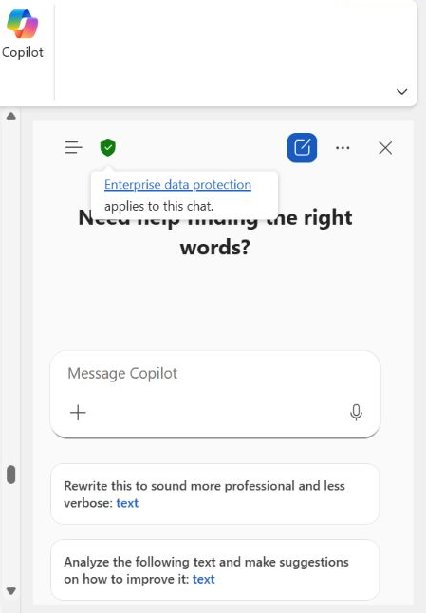
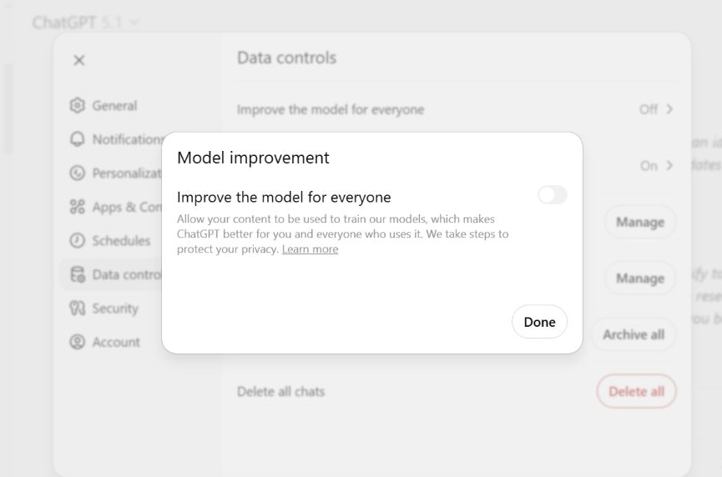
Security Feature Examples
CHAT GPT 5 – DISABLE MODEL TRAINING
COPILOT – ENTERPRISE DATA PROTECTION
Chat GPT
click your profile icon
Select Settings
Go to Data Controls
Turn Off “Improve the model for everyone"

Slide 26
10 Point Action Checklist
1. Map your personal data flows and activities and identify legal bases
2. Audit & update your privacy policies, procedures and documents to reflect DUAA changes
3. Review your
cookie banner / tracking setup &
adjust consent
/opt-out
4. Review your ADM/AI use: document safeguards
5. Review your data subject rights handling procedure
6. Establish a complaints process and enabling mechanisms
7. Review international transfers: check safeguards
8. Monitor secondary legislation & ICO/MRS guidance for start dates and sector-specific rules
9. Check the EC’s adequacy decision for the UK - 27th December 2025
10.Have a Happy Christmas!
Notes:
Most of the changes are not yet in full effect and are expected to be phased from January-June 2026.
This checklist will help you to start preparing and be ready for those changes

Slide 27


